Slide 1

Recent Global and National Developments in Housing-Related Lead Poisoning Prevention
David E. Jacobs, PhD, CIH
Research Director, NCHH
The Lead Poisoning Prevention Program
and Children’s Hospital at Montefiore
November 2015, New York

Slide 2
Outline
Global Developments
Production of New Lead Paint & US Companies
Public Nuisance Law & California
New Responsibilities and Collaboration –
clinical, exposure assessment, hazard
control professionals
Lead Standards, Window Replacement
Conclusions

Slide 3
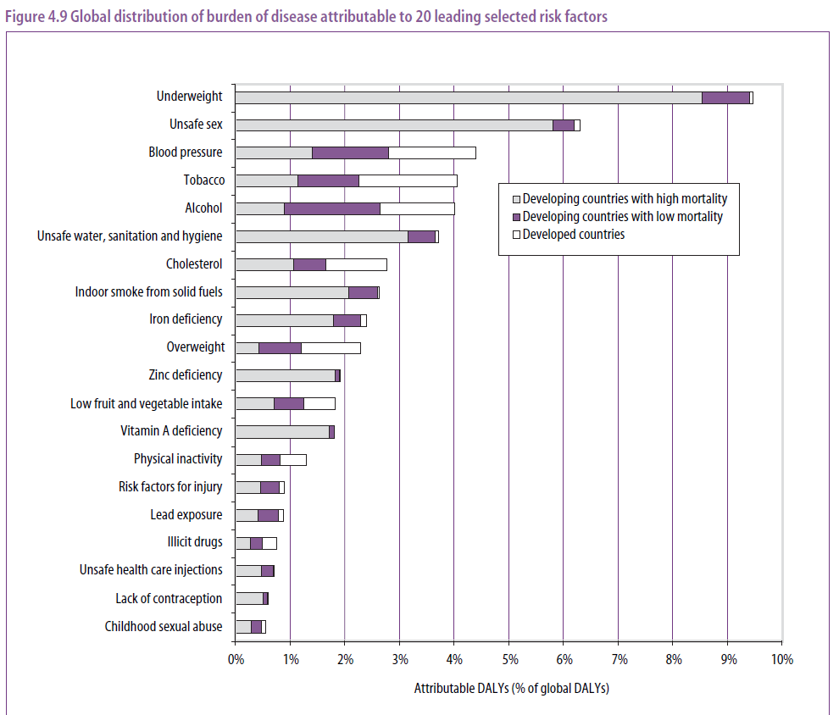

Slide 4
Long-Term Lead Production Increase

Slide 5
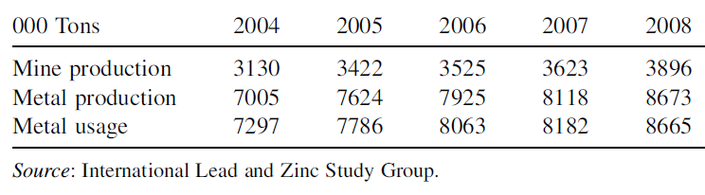
World Lead Production & Use

Slide 7
Reference Value vs. Reference Dose
The CDC lead reference value is the 97.5th
percentile of the blood lead distribution
The EPA reference dose is an estimate
(including uncertainty) of a daily oral intake
that is likely to not result in adverse health
effects during a lifetime.
Why did EPA never establish a reference
dose for lead?

Slide 8
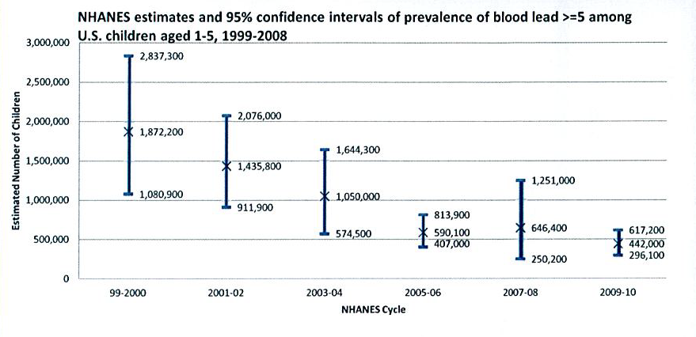
Recent NHANES Data

Slide 9
U.S. Selected Lead Poisoning Prevention Policies
Lead-based Paint Poisoning Prevention Act (1971)
Air & Ind Workplace Standards (1978)
Lead in Plumbing banned (1986)
Title X Housing & Community Development Act (1992)
Federally Assisted Housing Rule 1999
18
Residential Lead Paint Ban (1978)
Lead Contamination Control Act (1988)
Virtual Elimination of Lead in Gasoline
McKinney Act
Public Housing Abatement (1989)
Housing Lead Dust & Soil Std Published (1999 & 2001)
Private Housing Lead Paint Grants (1991)
Renovation/Painting Rule Published (2008)
Phase-out gasoline & lead soldered cans (1973)
Ban on lead solder
in food cans (1995)
Const Work Stds (96)
Lead Disclosure Rule (1996)
Housing units with lead paint reduced by 40% since 1990
‘72
‘74
‘76
‘78
‘80
‘82
‘84
‘86
‘88
‘90
‘92
‘94
‘96
‘98
‘00
‘02
‘04

Slide 10
  Tetraethyl lead for planes (AV gas) is still legal as is lead in paint for most applications outside of homes.
  The U.S. imported 5,703,798 kg of tetraethyl lead in 2011.
  At the same time the U.S. exported 7,786,000 kg of lead pigments in 2010.

Slide 11
Global Paint Market
$87 Billion (USD)
Source: PPG 2010 available at http://www.ppg.com/corporate/investorcenter/Documents/InvestorVisitViktorSekmakas.pdf

Slide 12
Oil-Based Paint Demand
Asia 2011
World 2011
Water-Based
* Estimated
Source: Freedonia Focus on World Architectural Paints, February 2008.

Slide 13
Lead paint is being sold in at least these 40 countries:
Argentina
Azerbaijan
Armenia
Bangladesh
Chile
India
Ivory Coast
Ethiopia
Kazakhstan
Kenya
Ghana
Kyrgyzstan
Tunisia
Uruguay
Uganda
Malaysia
Belarus
Brazil
China
Cameroon
Ecuador
Egypt
Indonesia
Lebanon
Malaysia
Mexico
Nepal
Nigeria
Paraguay
Peru
Philippines
Russia
Singapore
South Africa
Sri Lanka
Taiwan
Tanzania
Thailand
Senegal
Seychelles
Tunisia

Slide 14
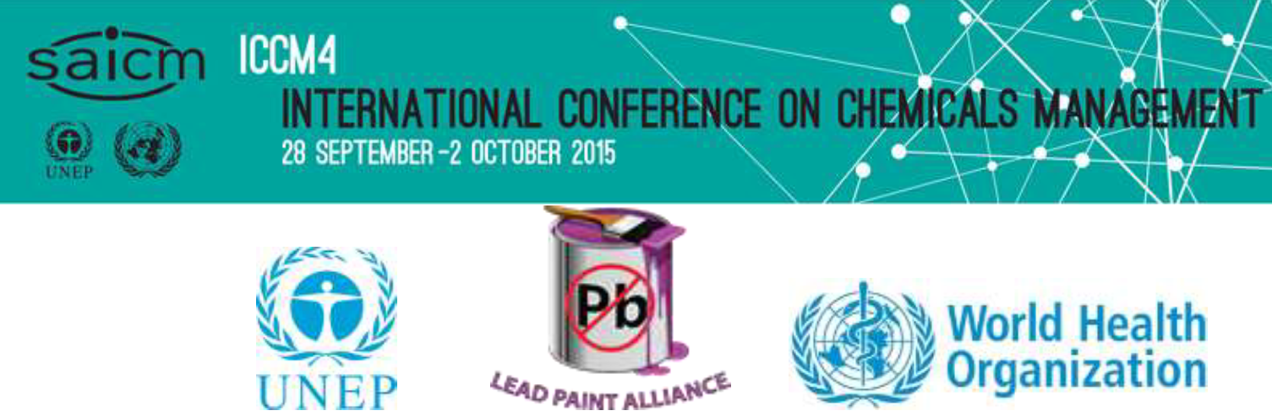

Slide 15
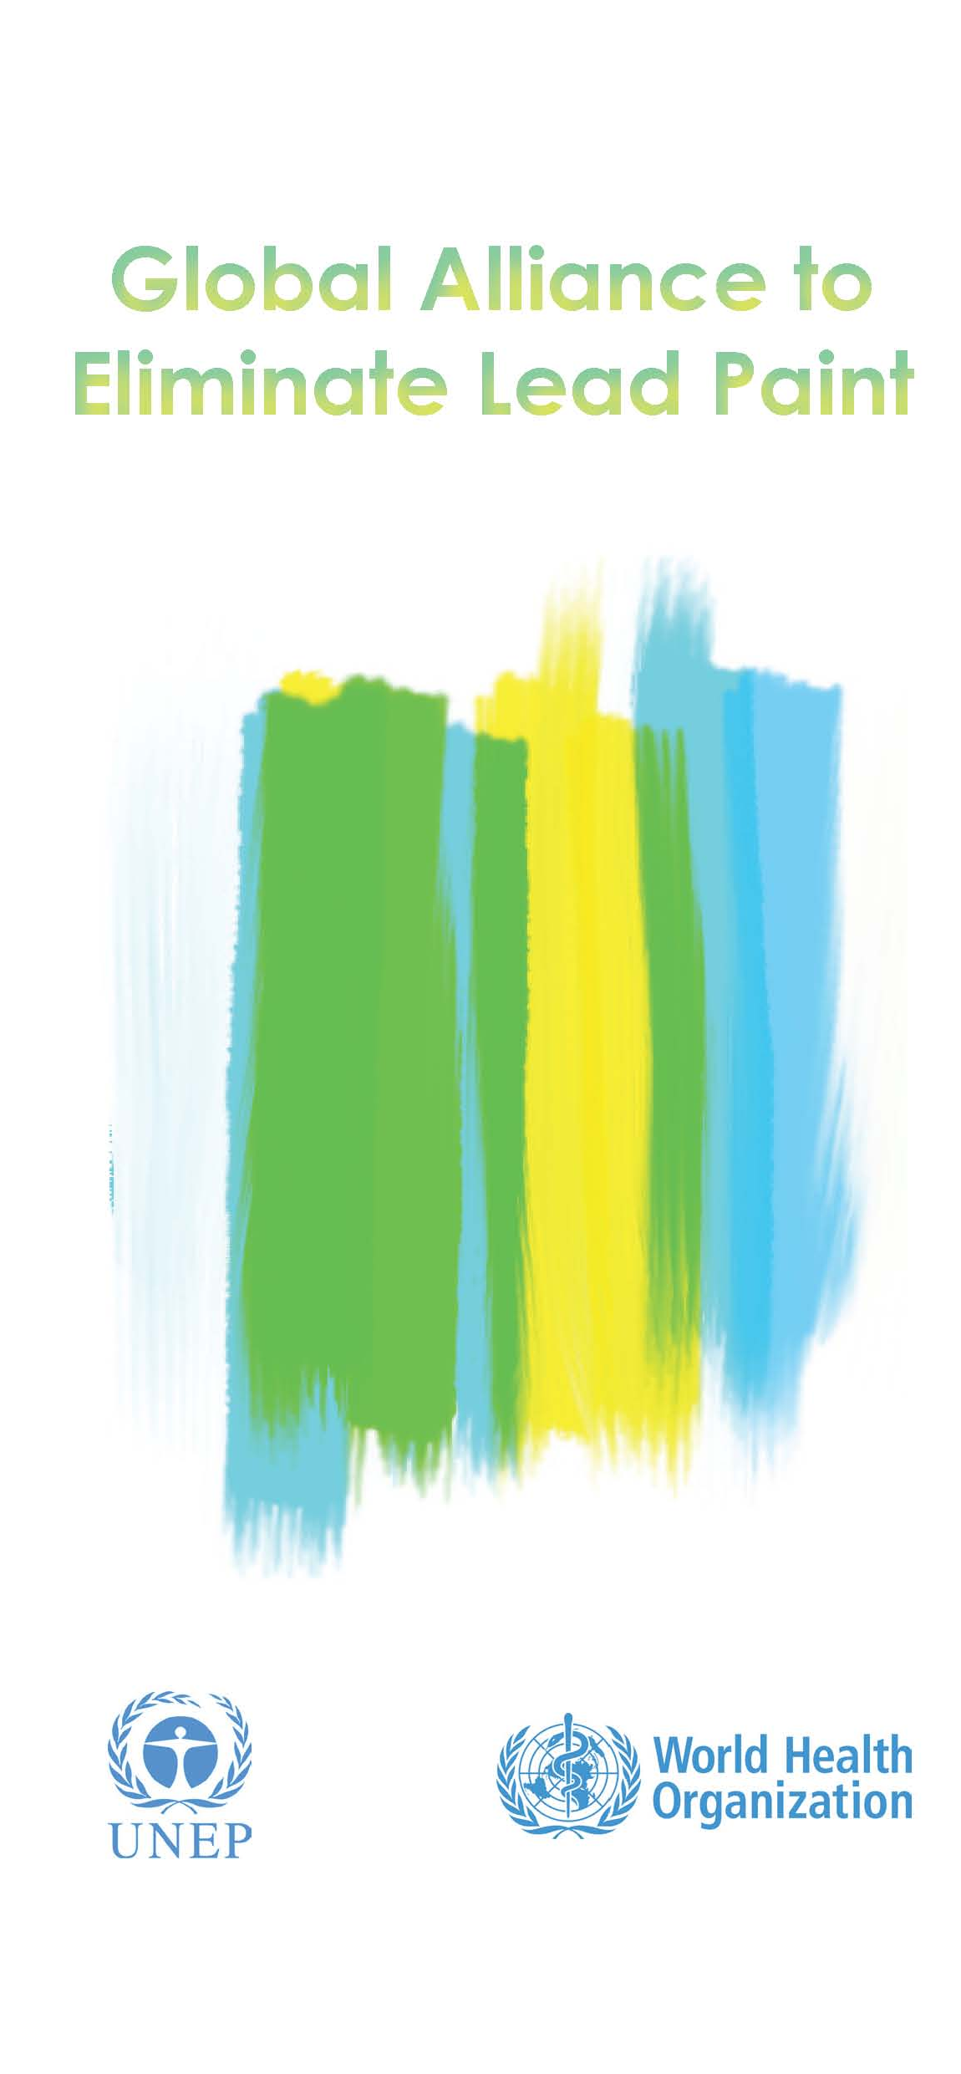

What is the Global Alliance to End Lead Paint?
A voluntary collaborative initiative formed the International Conference on Chemicals Management (ICCM2) by Resolution II/4 B (2009):
Goal to prevent children's exposure to lead from paint and to prevent occupational exposures to lead paint;
Operated under a joint secretariat of WHO and UNEP;
Current Chair of GAELP is U.S. EPA.
Broad objective
To phase out the manufacture and sale of paints containing lead and, eventually, to eliminate the risks that such paints pose.
GLOBAL ALLIANCE TO ELIMINATE LEAD PAINT

Slide 16
Global Alliance to Eliminate Lead Paint (GAELP) through UN process on Chemicals Management.
In the absence of regulation, paint companies must reformulate and list ingredients to inform consumers.
Third party certification to reward companies that reformulate by gaining recognition with a logo on their products.

Slide 17
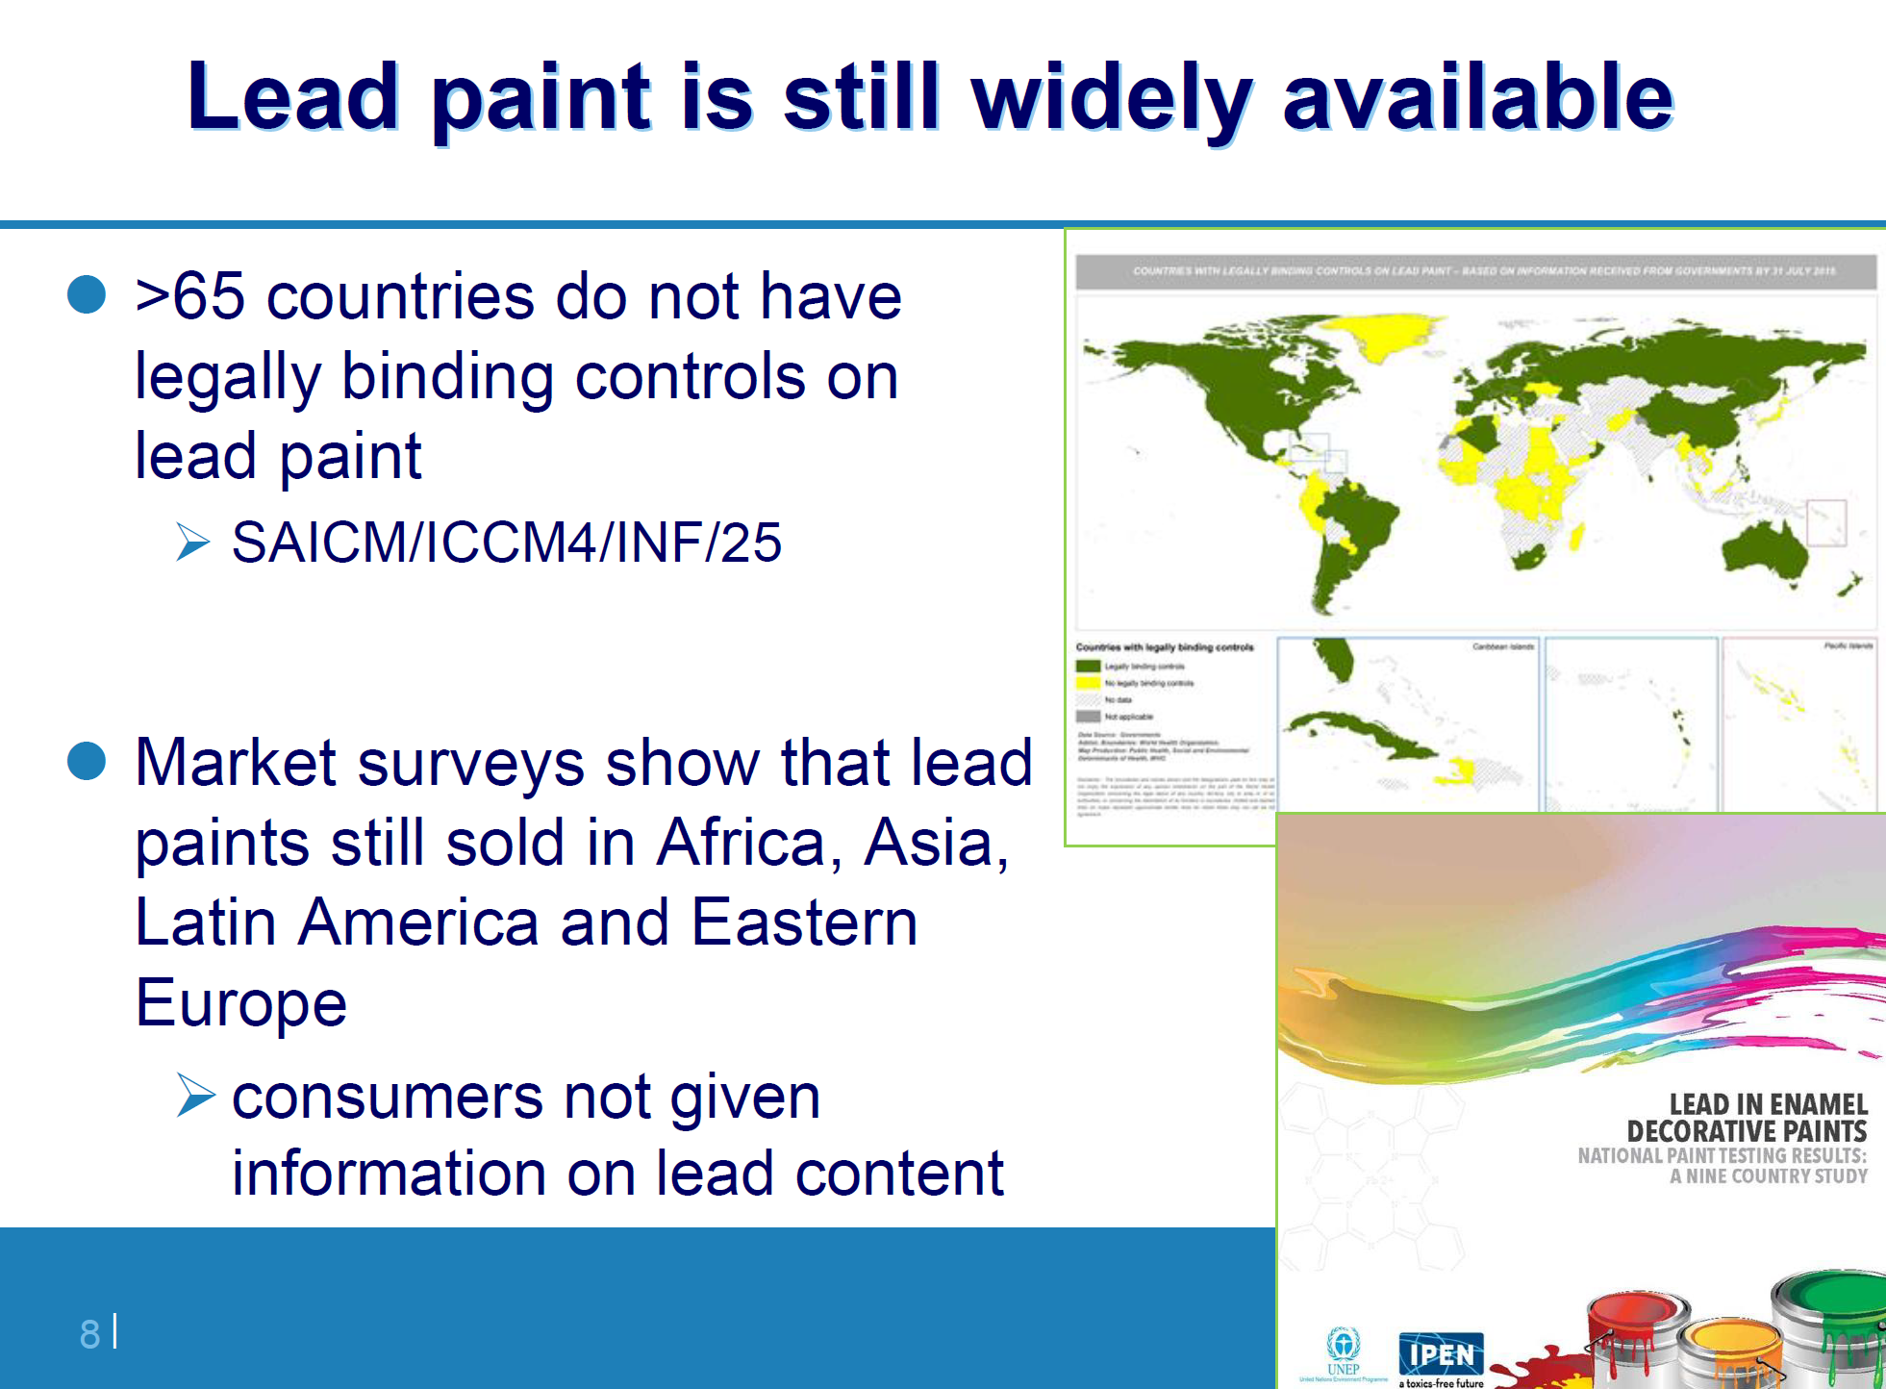

Slide 18
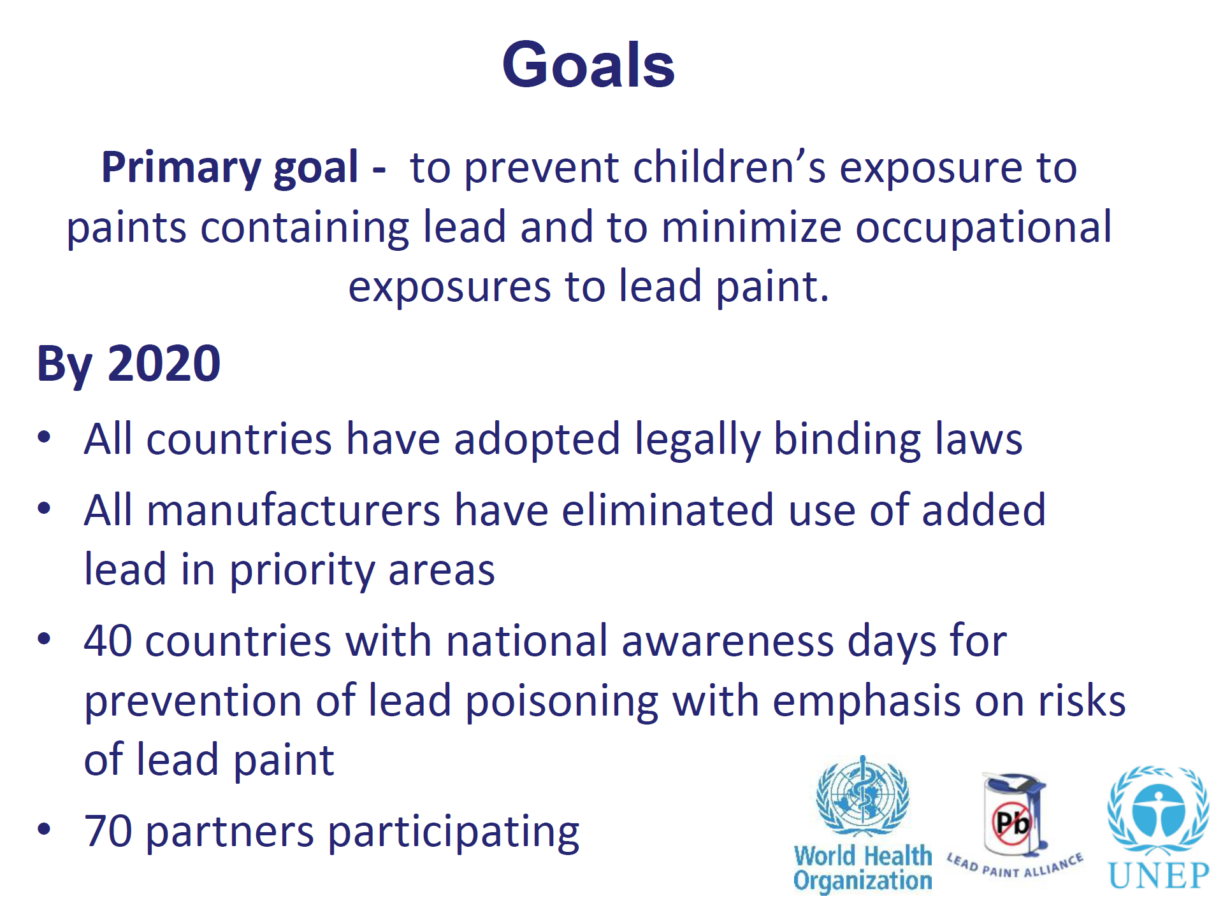

Slide 19
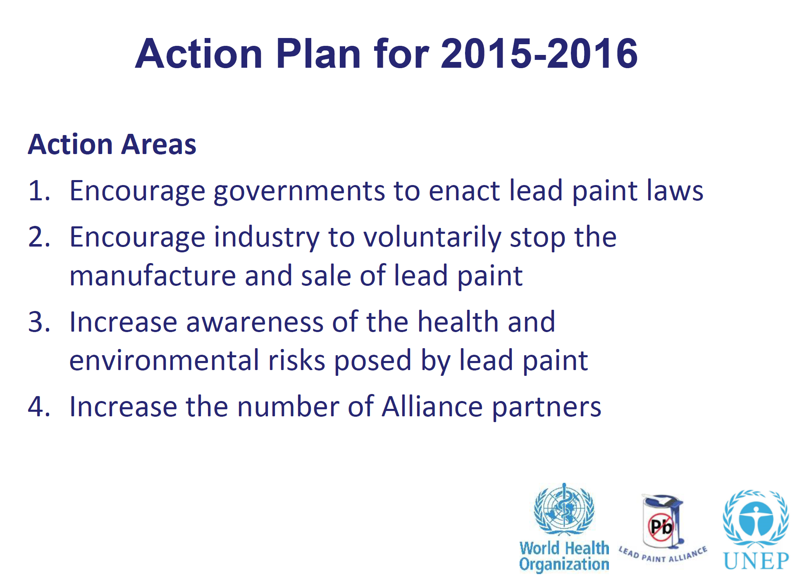

Slide 20
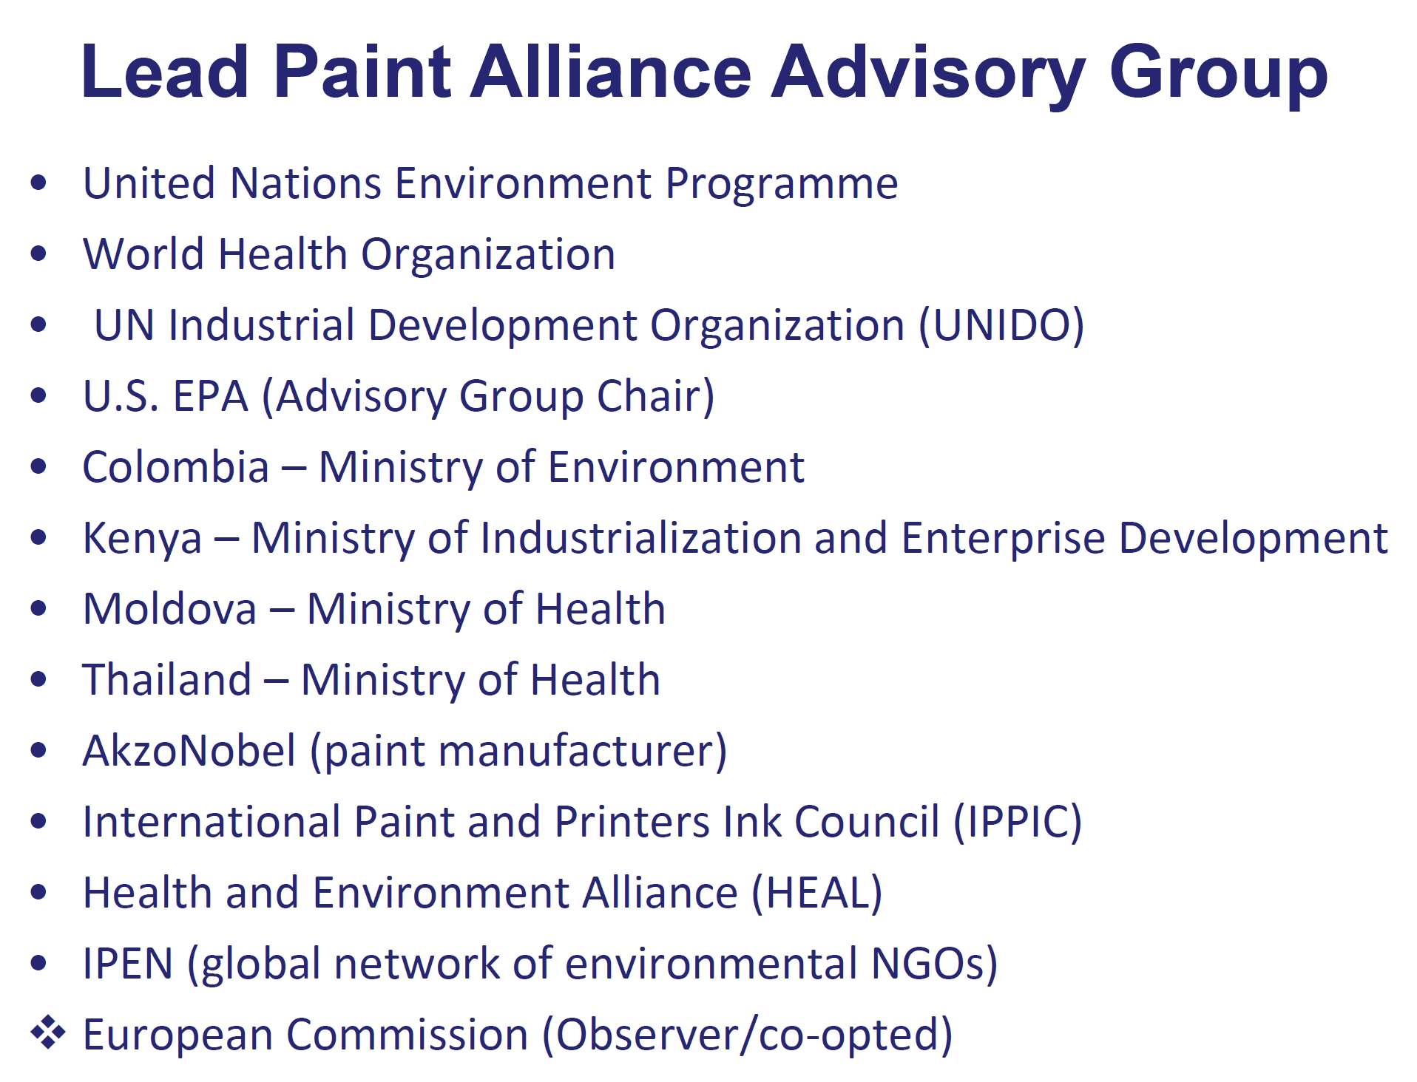

Slide 21
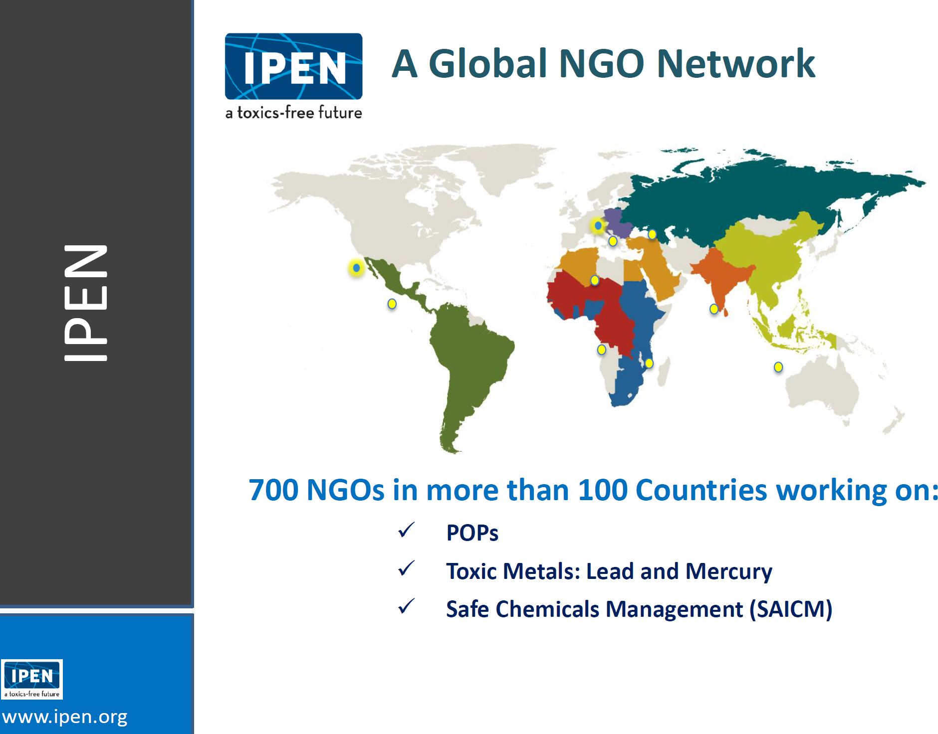

Slide 22
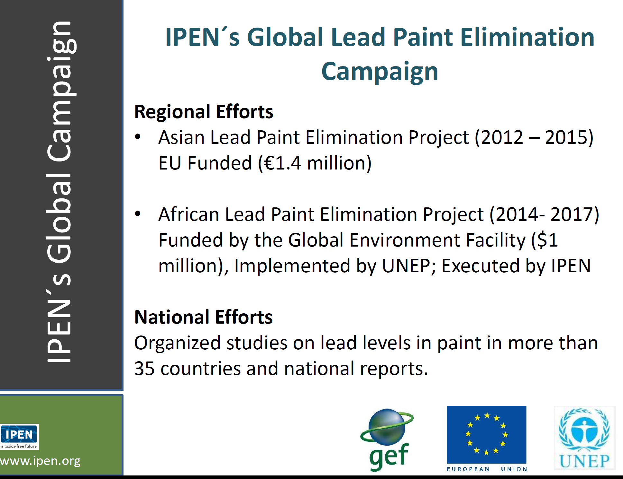

Slide 23
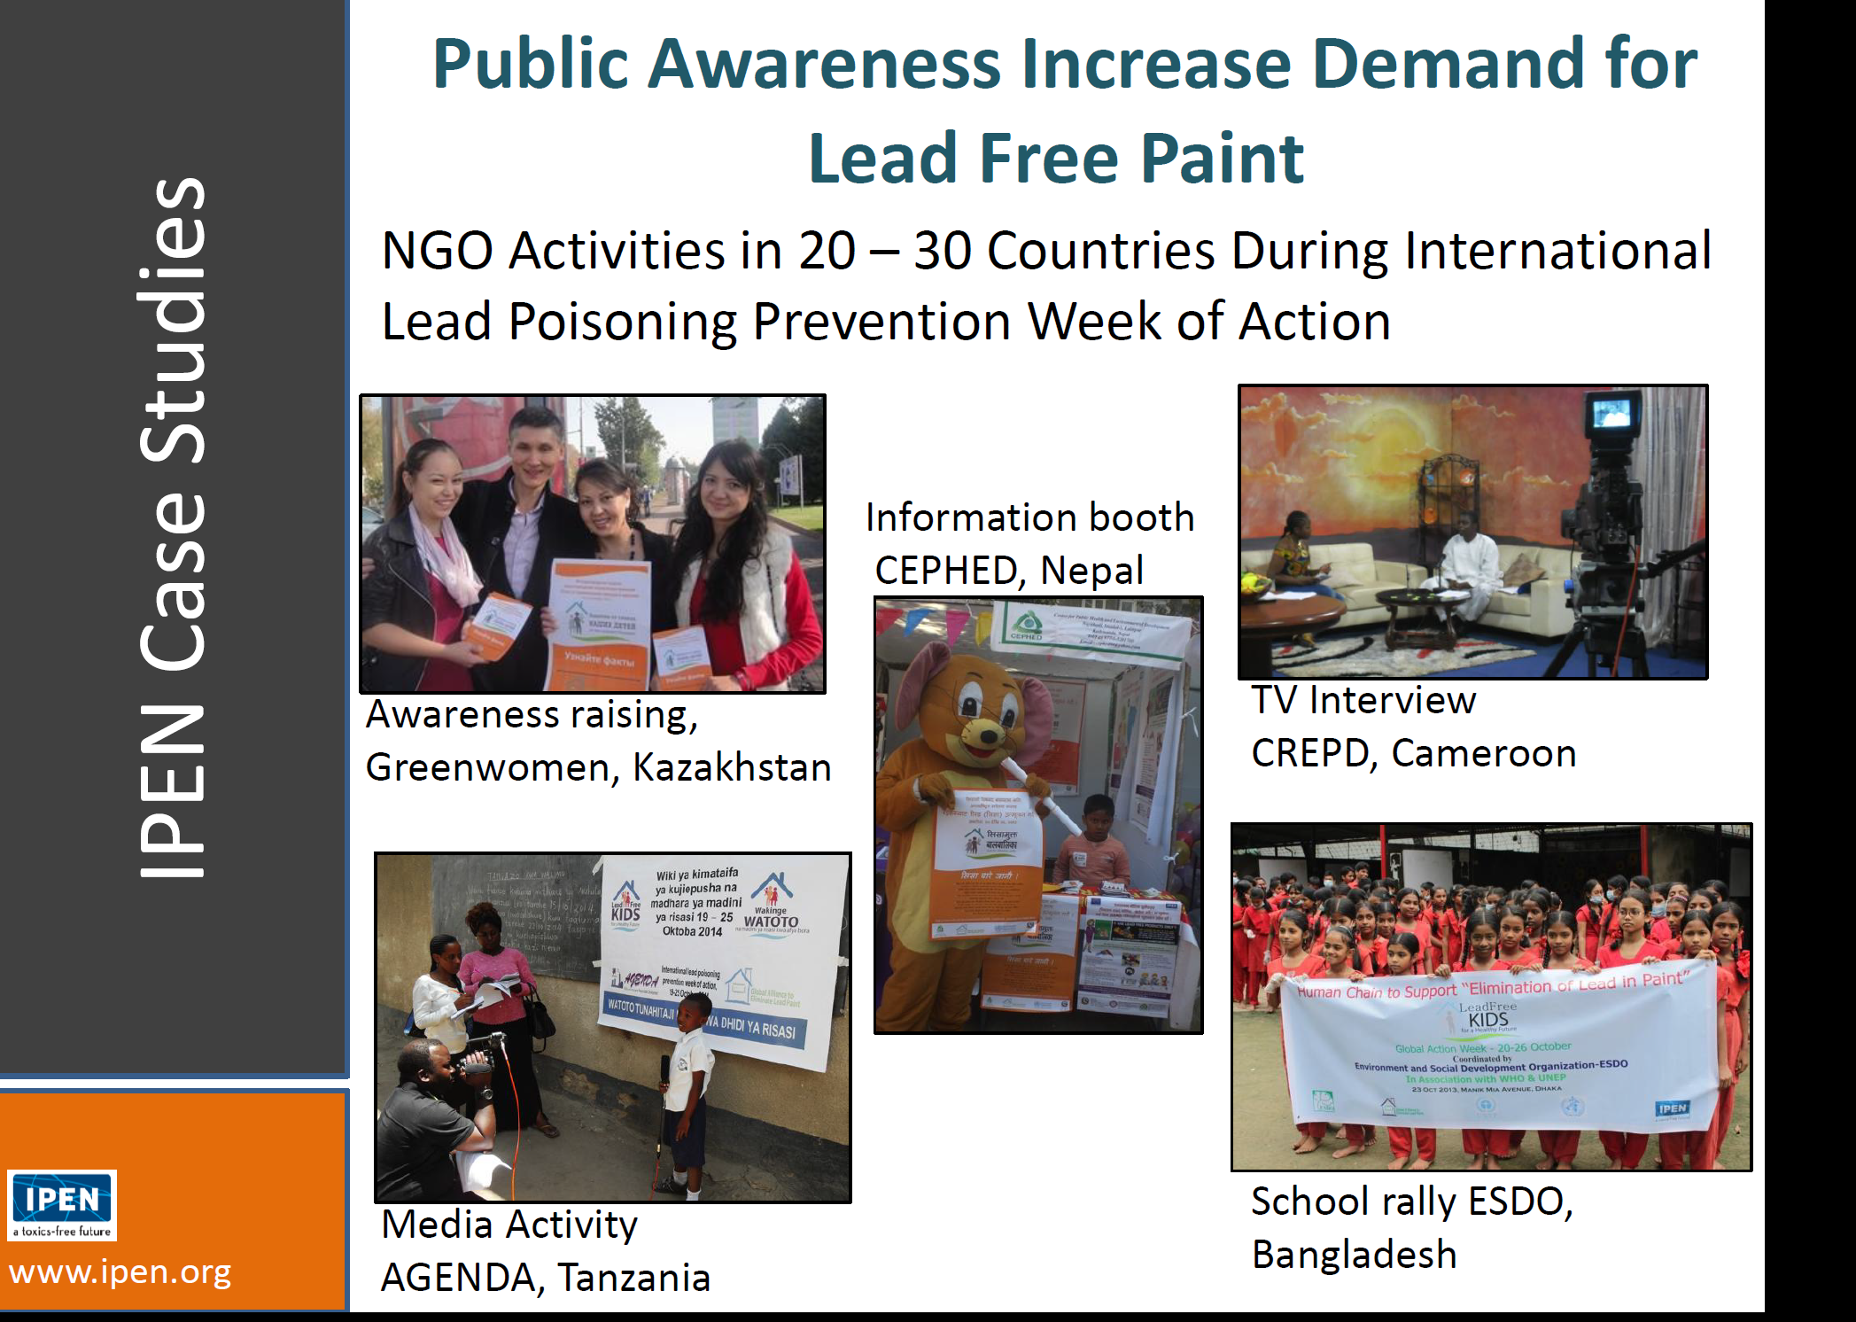

Slide 24
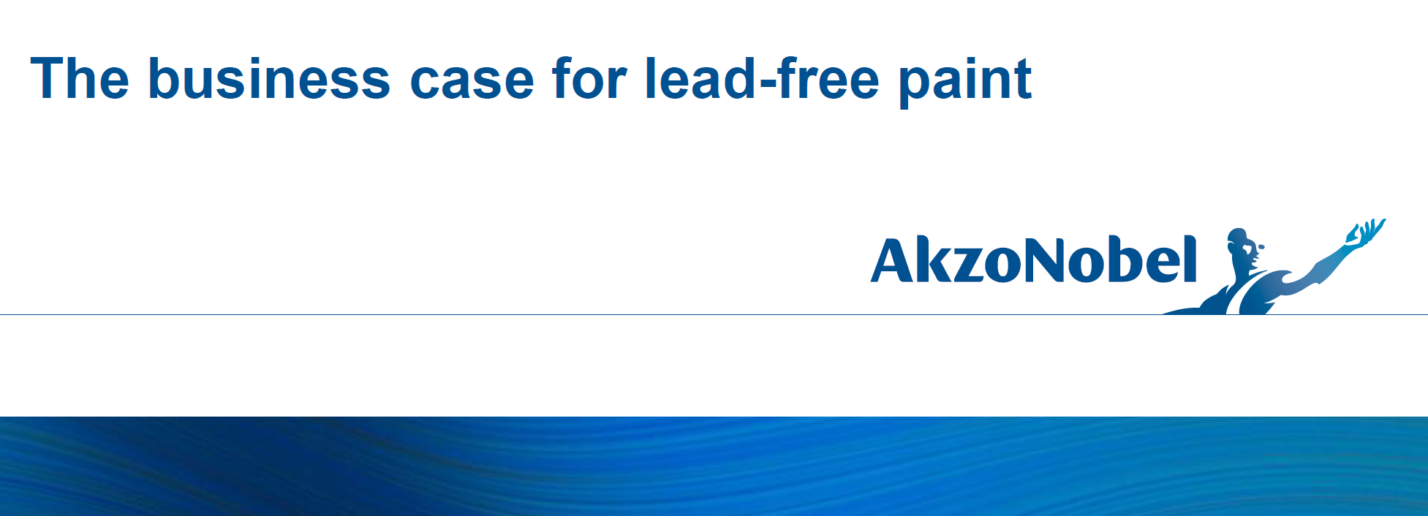

Slide 25
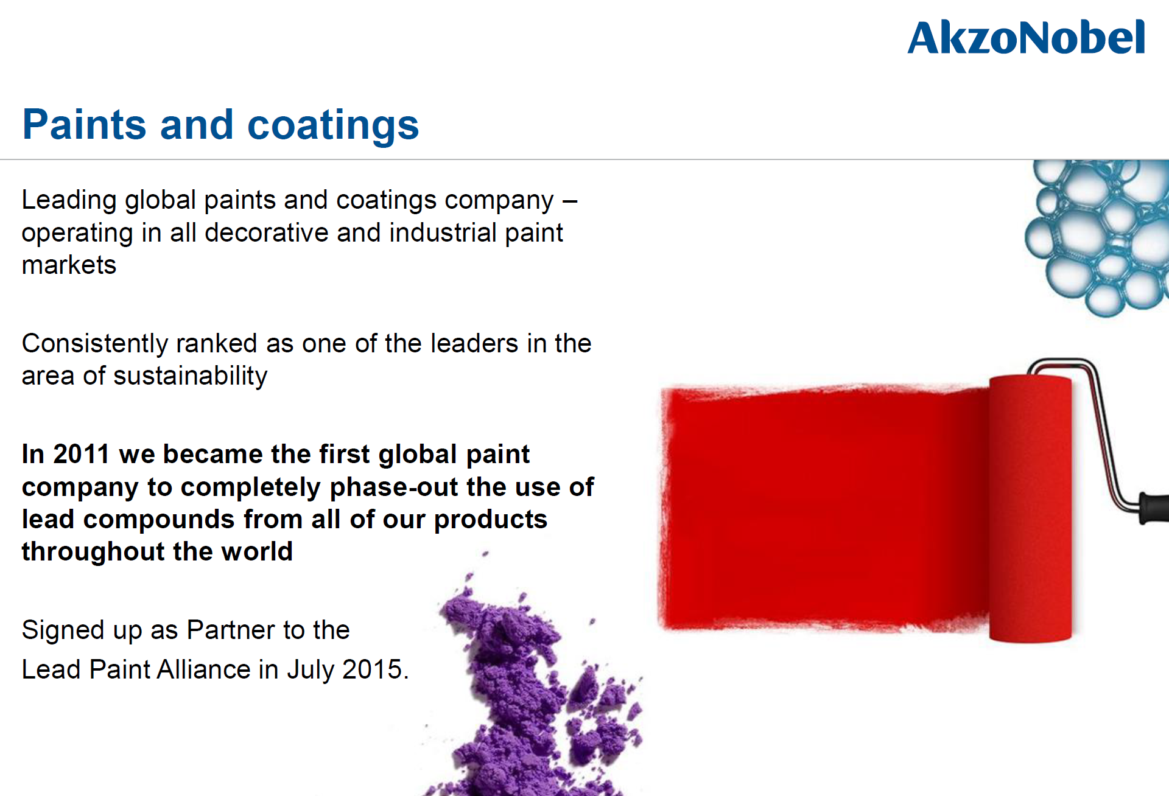

Slide 26
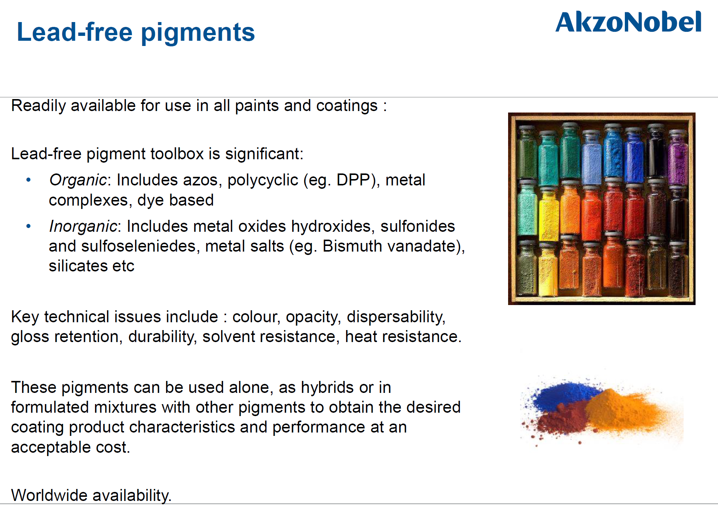

Slide 27
Who Is the World’s Second Largest Paint Company? Sherwin-Williams:
Still refuses to stop manufacturing new lead-based paint in developing nations.
Fought off a group of socially responsible investors demanding end to lead paint
Filed a brief before the Securities and Exchange Commission by arguing that their decision to manufacture and sell lead paint is “ordinary business” and therefore not subject to shareholder actions.
AND….

Slide 28
Background on CA Case
13 years of litigation, beginning in 2000
2006: California Court of Appeal, Sixth Appellate District, clarified what had to be proved to show that lead pigment was a “public nuisance”
In 2010 alone, at least 21,000 California children under the age of six were poisoned by lead

Slide 29
The decision holds accountable those who are to blame, who caused this problem, for the first time.
If you make a mess, you have to clean it up.
And if it’s your mess, it won’t matter how hard you try to make it seem like it’s someone else’s mess, you STILL have to clean it up.
Definition of “abatement”

Slide 30
The Verdict
3 Companies – Sherwin Williams, Conagra and National Lead
Ordered to pay $1.15 Billion
To fund the “abatement” of the public nuisance they created through their promotion and sale of lead pigment in ten California cities and counties

Slide 31
The Law
2006 Court of Appeals – California defined the law of public nuisance in the context of lead pigment litigation
  A public nuisance can be “Anything which is injurious to health …or is indecent or offensive to the senses, or an obstruction to the free use of property…”

Slide 32
The Law – Continued
  Denied the companies’ request to dismiss the case.
  Public Nuisance Standard: must prove “promotion of lead paint for interior use with knowledge of the hazard that such use would create.”

Slide 33
Public Nuisance v. Product Liability
  Public nuisance action was not seeking money damages for physical injuries or property damage that had already occurred

Slide 34
  The People were seeking abatement of the lead paint hazards before the hazards could cause further physical injuries to children or damage to properties
  “A products liability action does not provide an avenue to prevent future harm from a hazardous condition, and it cannot allow a public entity to act on behalf of a community that has been subjected to a widespread public health hazard.”

Slide 35
“Liability for nuisance does not hinge on whether the defendant owns, possesses or controls the property, nor on whether he is in a position to abate the nuisance; the critical question is whether the defendant created or assisted in the creation of the nuisance.”
Public Nuisance liability is based on promoting the product for use, with knowledge of the hazard such use would create. Product Liability is based on the failure to warn.

Slide 36
Trial Court’s Finding of Fact
White lead carbonate in paint is harmful, particularly to children
There is no safe level of lead in blood
Lead causes significant physical harm and has lasting effects, including diminished intellectual capacity
There is a clear and present danger from lead in homes that needs to be addressed

Slide 37
Trial Court’s Finding of Fact - Continued
Defendants promoted and sold lead paint in the Jurisdictions for years, and in some cases for decades
Defendants sold lead paint with actual and knowledge that it was harmful
Lead paint is prevalent in the jurisdictions and is of continuing adverse effect

Slide 38
Trial Court’s Finding of Fact - Continued
While there have been significant reductions in tested blood lead levels over time, the issues presented in this case are not resolved

Slide 39
Trial Court’s Conclusions of Law - Continued
“Ultimately, society will pay for these problems over time.”
The Court endorses and adopts a “prevention based approach” to lead poisoning, the goal of which “is to pre-emptively avoid lead exposure rather than handle cases of exposure exceeding a certain limit after they occur.”

Slide 40
Trial Court’s Conclusions of Law - Continued
“Lead paint is the primary source of lead poisoning for children in the Jurisdictions who live in pre-1978 housing.” Alternative sources of lead, such as imported food or pottery, pointed to by the companies as the real problem, only contributed to small amounts of lead exposure and were easily removed from a child’s environment.

Slide 41
Trial Court’s Conclusions of Law - Continued
The Court exonerated two of the five companies from liability, one for the lack of evidence of promotion, the other for the lack of evidence in its interior paint.
The Court expressly found that the other three companies - Sherwin Williams, Conagra and NL- promoted lead in paint for interior use with knowledge of hazard of lead, creating a public nuisance in the ten prosecuting jurisdictions.
The Court ordered these three companies to fund a plan that would abate the nuisance they created.

Slide 42
Industry Misinformation
“Slumlords are the big winners” – In fact, no money will go to property owners, instead will go to fix the problem
“The abatement plan will provide new roofs” – In fact the plan will only stop water leaks that will make interior abatement short-lived
“The industry sold a legal product” – Actually, it was illegal in most of the world around 1920; and the reason it was legal in the US is because they lobbied to make it so
“The abatement plan is inconsistent with state and federal policy” In fact, the abatement plan uses the tried and true methods we have been practicing for years and is entirely consistent

Slide 43
The Plan does not require full-fledged removal of all lead paint from all surfaces in all homes. It provides the following:
  Testing and inspection of interior surfaces to identify the presence of lead based paint and the presence of lead based paint hazards.

Slide 44
The Abatement Remedy - Continued
  Remediation of lead based paint on friction surfaces (including windows, doors and floors) by replacement of the building component and/or enclosure of the lead paint.
  Remediation of lead paint hazards on all other surfaces using clearance lead dust levels below, and more protective, than the existing EPA standards.

Slide 45
The Abatement Remedy - Continued
  Dust removal, clean-up control and clearance dust testing.
  The repair of building deficiencies (e.g. water leaks) to ensure the durability of the lead hazard controls.
  Education of families and homeowners on lead poisoning prevention.

Slide 46
The Abatement Remedy - Continued
The program will last 4 years from the date of the payment of the funds by the defendants. Any funds remaining after that time will be returned by the defendants. The Court will have continuing jurisdiction over the Plan and its implementation.

Slide 47
Target Others
The decision ends the finger pointing—it’s a problem of the poor, or no education, or gasoline, or bad slumlords
Weaver debate

Slide 48
Scope
“Of course, by any measure, the remedy sought by the People is of substantial, even massive proportions.
“Seeking the abatement of lead by inspections and rehabilitation of tens of thousands of homes – at a minimum -- is a daunting decision.
“But the Court is convinced that…thousands of children in the jurisdictions are still presently and potentially victimized by this chemical.”

Slide 49
To Learn More
To View Full Decision and Learn More:
bit.ly/CALeadDecision

Slide 50
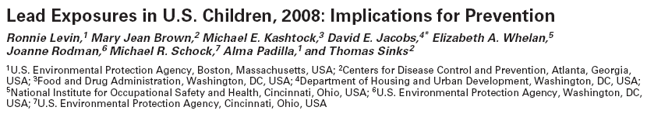
Lead is a Multi-Media Pollutant
70% of Poisoning Due to Housing

Slide 52
Primary Prevention
Rather than responding to exposure after it has take place, prevent it.
Primary prevention is necessary because the
effects of lead appear to be irreversible.
In the U.S., this will largely require that children
not live in housing with lead-based paint
hazards.
Limiting our actions to screening children for elevated BLLs and dealing with their housing only when their BLL is already elevated should no longer be acceptable practice.

Slide 53
New Roles and Responsibilities
Clinicians should monitor blood lead in at-risk children
Environmental & housing professionals and
allied fields should measure lead in sources and pathways to protect all children before they are exposed
If a child is above the reference value, it means
there is an exposure(s) that must be controlled
Risk assessors should identify exposure sources and pathways and recommend needed interventions based on environmental levels, not only blood lead

Slide 54
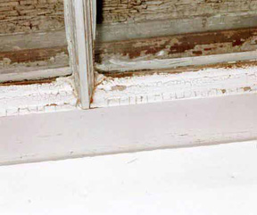
Number of Houses with Lead Paint
1990 – 64 Million
2000 – 38 Million
2006 – 37 Million
    Source: Jacobs, et al. “Prevalence of Lead-Based Paint Hazards in Housing,” Env Health Persp., 110: A599-606 (2002) & HUD (2011)

Slide 55
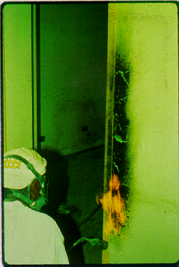
Use only safe hazard control methods
NOT THIS

Slide 56
Safe Hazard Control Means:
Occupant & Worker & Environmental Protection
Containment
Building Component Replacement
Enclosure
Encapsulation
Limited Paint Removal Using Approved Methods
Lead Paint Stabilization
Specialized Cleanup & Waste
Clearance & Compliance with Lead Dust Standards
See: HUD Guidelines

Slide 57
History of Floor PbD Standard
Bioavailabile PbD fraction
  200 µg/ft² (Farfel et al. – Baltimore Late 1980’s),
  based on PbB of 25 µg/dL
Total PbD
  100 µg/ft² (EPA Guidance, 1995)
  40 µg/ft² (HUD Standard, 1999)
  40 µg/ft² (EPA Standard, 2001)

Slide 58
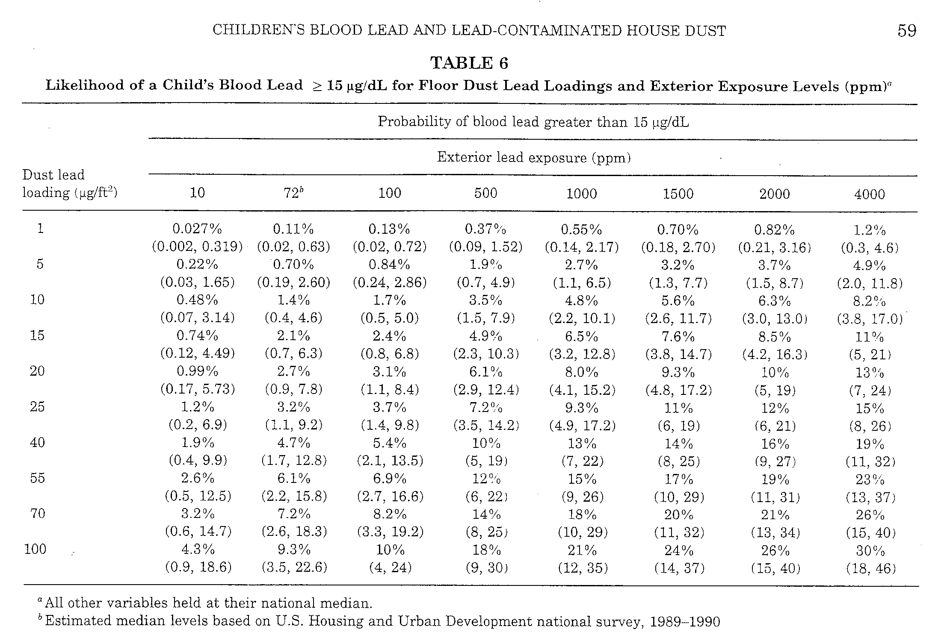

Slide 59
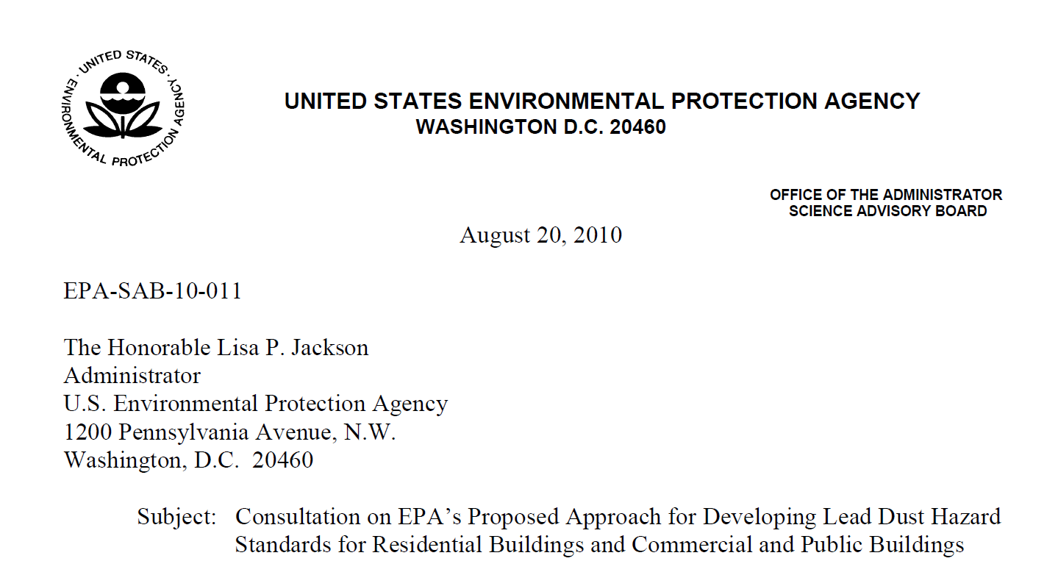

Slide 60
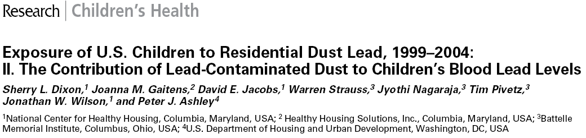
NHANES Dust & Blood Data

Slide 61
Floor Dust Lead | % Children above 10 ug/dL | % Children above 5 ug/dL | % Homes Above dust lead
<5 ug/ft² (Limit of Detection) | 2.3 | 14 | 4.9
<10 ug/ft² | 4 | 24 | 3
<40 ug/ft² (current EPA Std) | 11.5 | 51.8 | 0.4

Slide 62
Dust Lead Recommendations
EPA should act on the 2010 EPA Science Advisory
Board Report on residential lead dust
standards
Parents, contractors, risk assessors and others
should keep Floor PbD < 10 µg/ft² and Sill PbD
< 100 µg/ft² as low as possible
Local jurisdictions should consider adopting
these levels

Slide 63
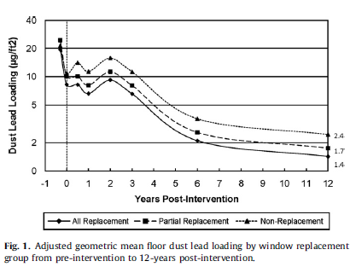
12 Year Study of Floor Dust Lead Levels with Lead-Safe Window Replacement

Slide 64
Cost/Benefit Estimate
(Gould, Env Health Persp 2009)
Each dollar invested in lead paint hazard control results in a return of $17-$221 or a net savings of $181-$269 billion (for each cohort of children < 6; better than vaccines!)
Includes: cost of lead hazard control, health care,
lost lifetime earnings, tax revenue, special education, crime, and attention deficit hyperactivity disorder

Slide 65
CLEAR WIN 2015

Slide 66

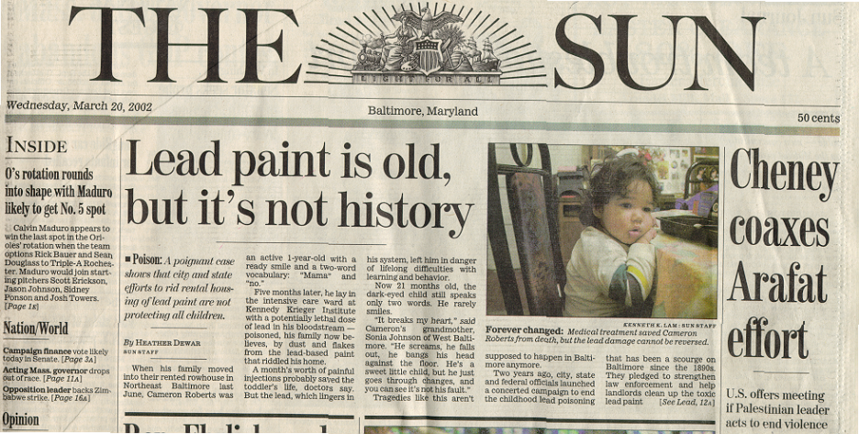

Slide 67
Conclusions
The spread of Global lead paint production must be stopped
US companies are contributing to that problem
More resources will be needed to provide lead
poisoning services to more children
Congressional attacks on CDC and HUD lead programs must be countered.
The goal of eliminating excessive exposures to
lead is long overdue.

Slide 68
Conclusions
Clinicians should refer those with exposures above the reference value to risk assessors and others who are trained to locate and eliminate sources and pathways.
Exposure control is assessed by comparison to environmental exposure limits, not blood lead level. Lead exposure limits for air, water, dust, and others should be updated.
Public health, environmental, and allied fields should advocate for the resources needed to protect children.
AND ABOVE ALL……

Slide 69

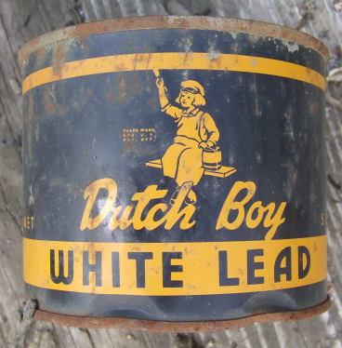
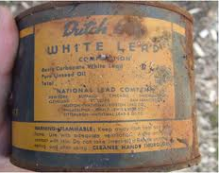

Slide 70
Contact Info
David E. Jacobs, PhD, CIH
Email: djacobs@nchh.org
www.nchh.org
Phone: 202-607-0938

