Slide 6
IQ Deficits Linked with an Increase in Blood Lead from 10 μg/dl to 20 μg/dl

Slide 8
Percent of Preschool Children Exceeding Selected Blood Lead Levels, NHANES II - III

Slide 9
Blood Lead Levels > 10 µg/dL among Children in Rochester, 1995

Slide 11
Lead Toxicity at Blood Lead Levels <10 μg/dl

Slide 12
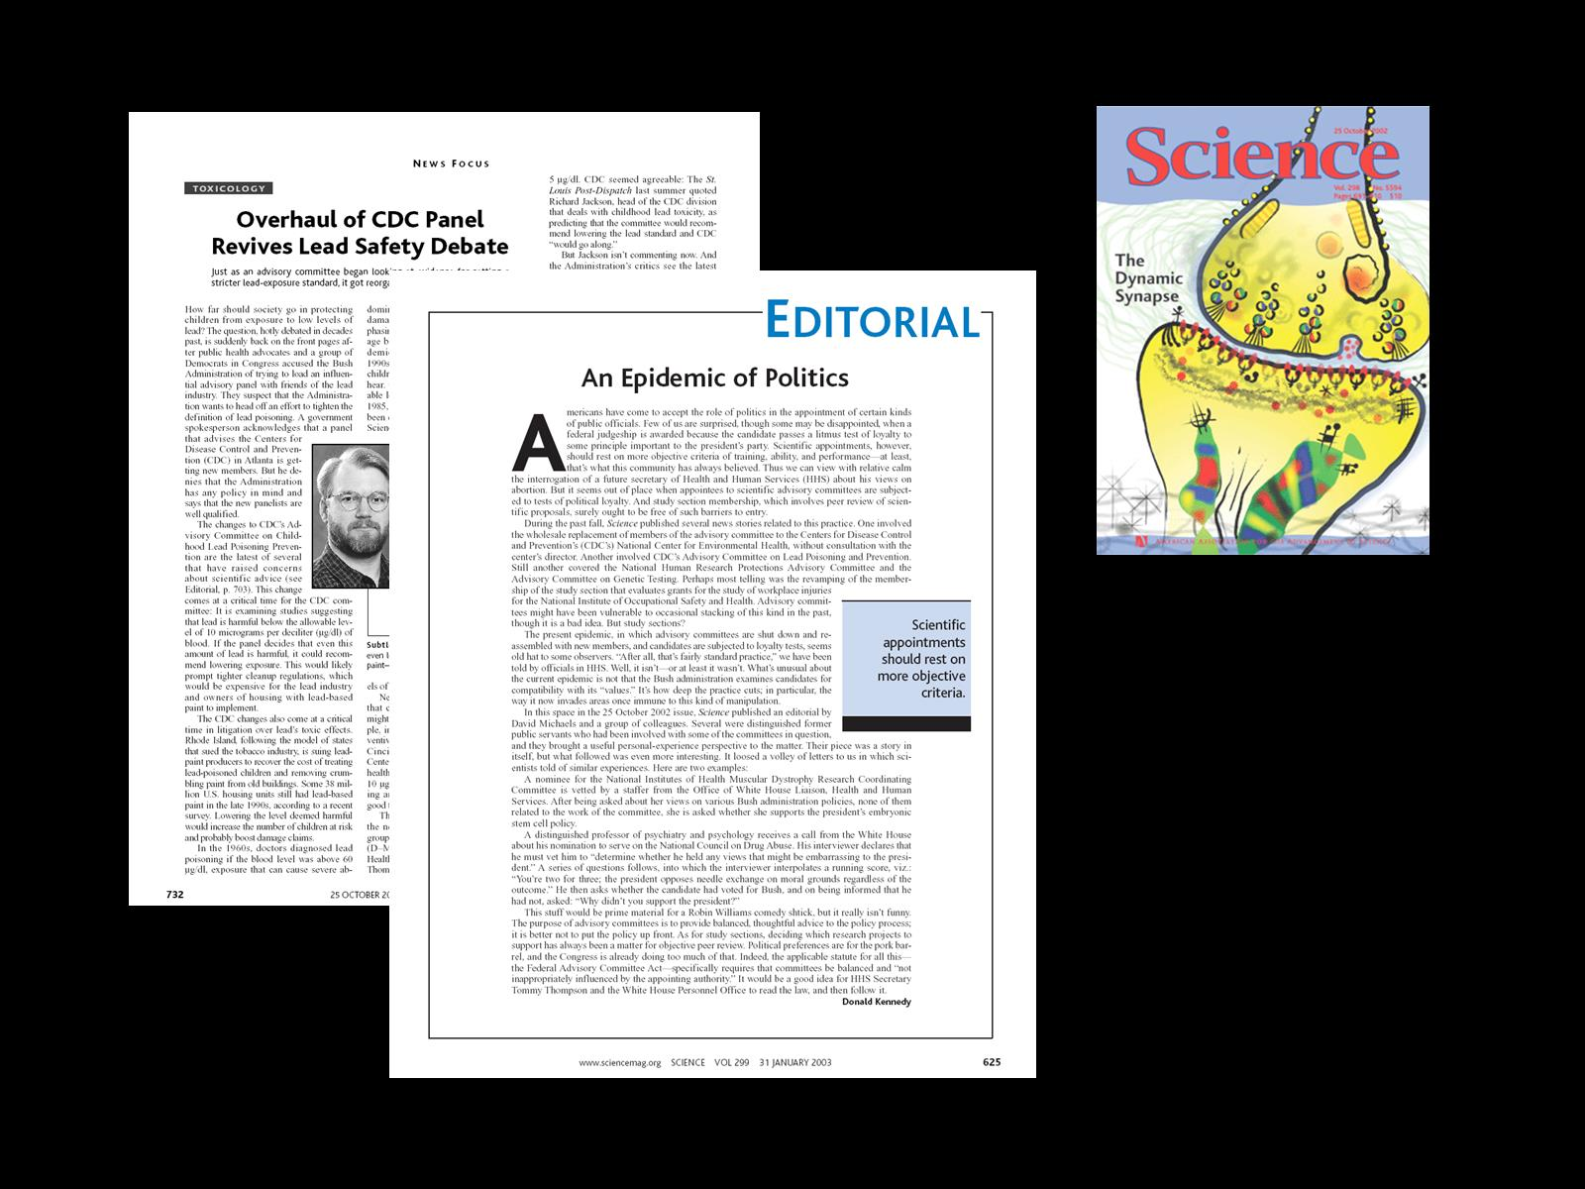

Slide 14
IQ Scores for Tibial Bone Lead and Mean Lifetime Blood Lead Levels

Slide 16
Why not change the blood lead level of concern at this time?

Slide 18
Mean IQ Change per 1 μg/dl at 5 years for Children with Peak Blood Lead < 10 μg/dl (n=101)

Slide 19
Mean IQ Change per 1 μg/dl at 5 years for Children with Peak Blood Lead < 10 μg/dl (n=101)

Slide 20
Research Supporting Adverse Cognitive Effects at Blood Lead Levels < 10 µg/dL (through 2008)

Slide 24
Lead Reduces Neurite Length in Dopaminergic Neurons after 48 Hr Exposure to Lead Acetate

Slide 28
The Prevention Paradox

Slide 30
Dose Response Relationship of Maternal Blood Lead Levels and Birthweight

Slide 34
Gray Matter Loss by Childhood Lead Exposure

Slide 35
Key Imaging Findings in ADHD

Slide 36
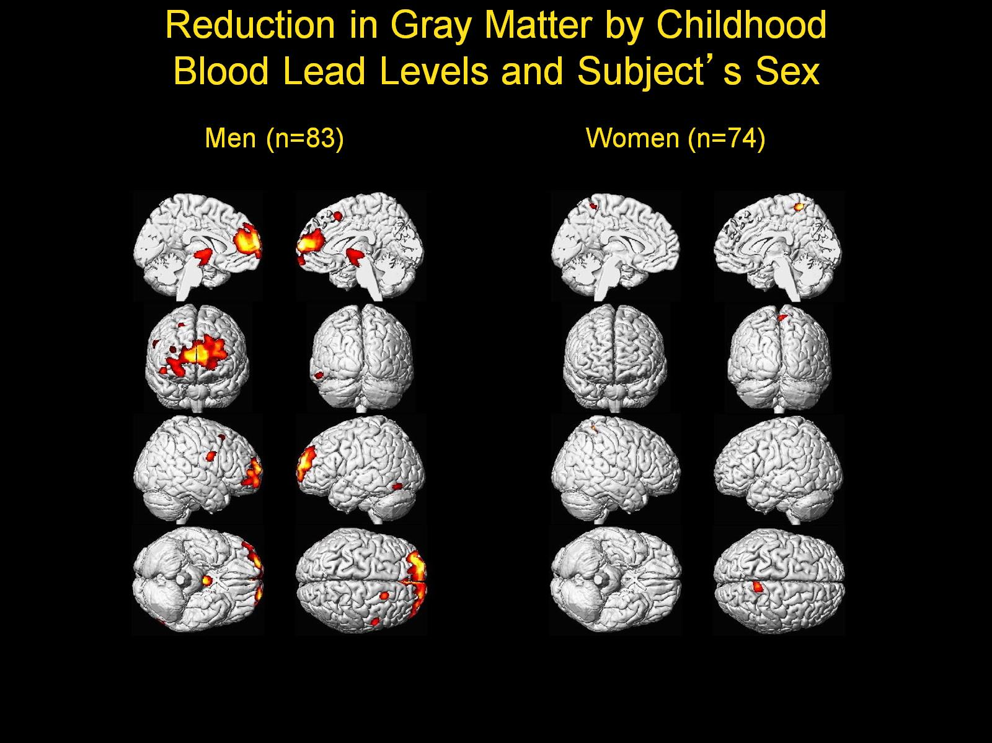
Reduction in Gray Matter by Childhood Blood Lead Levels and Subject’s Sex

Slide 39
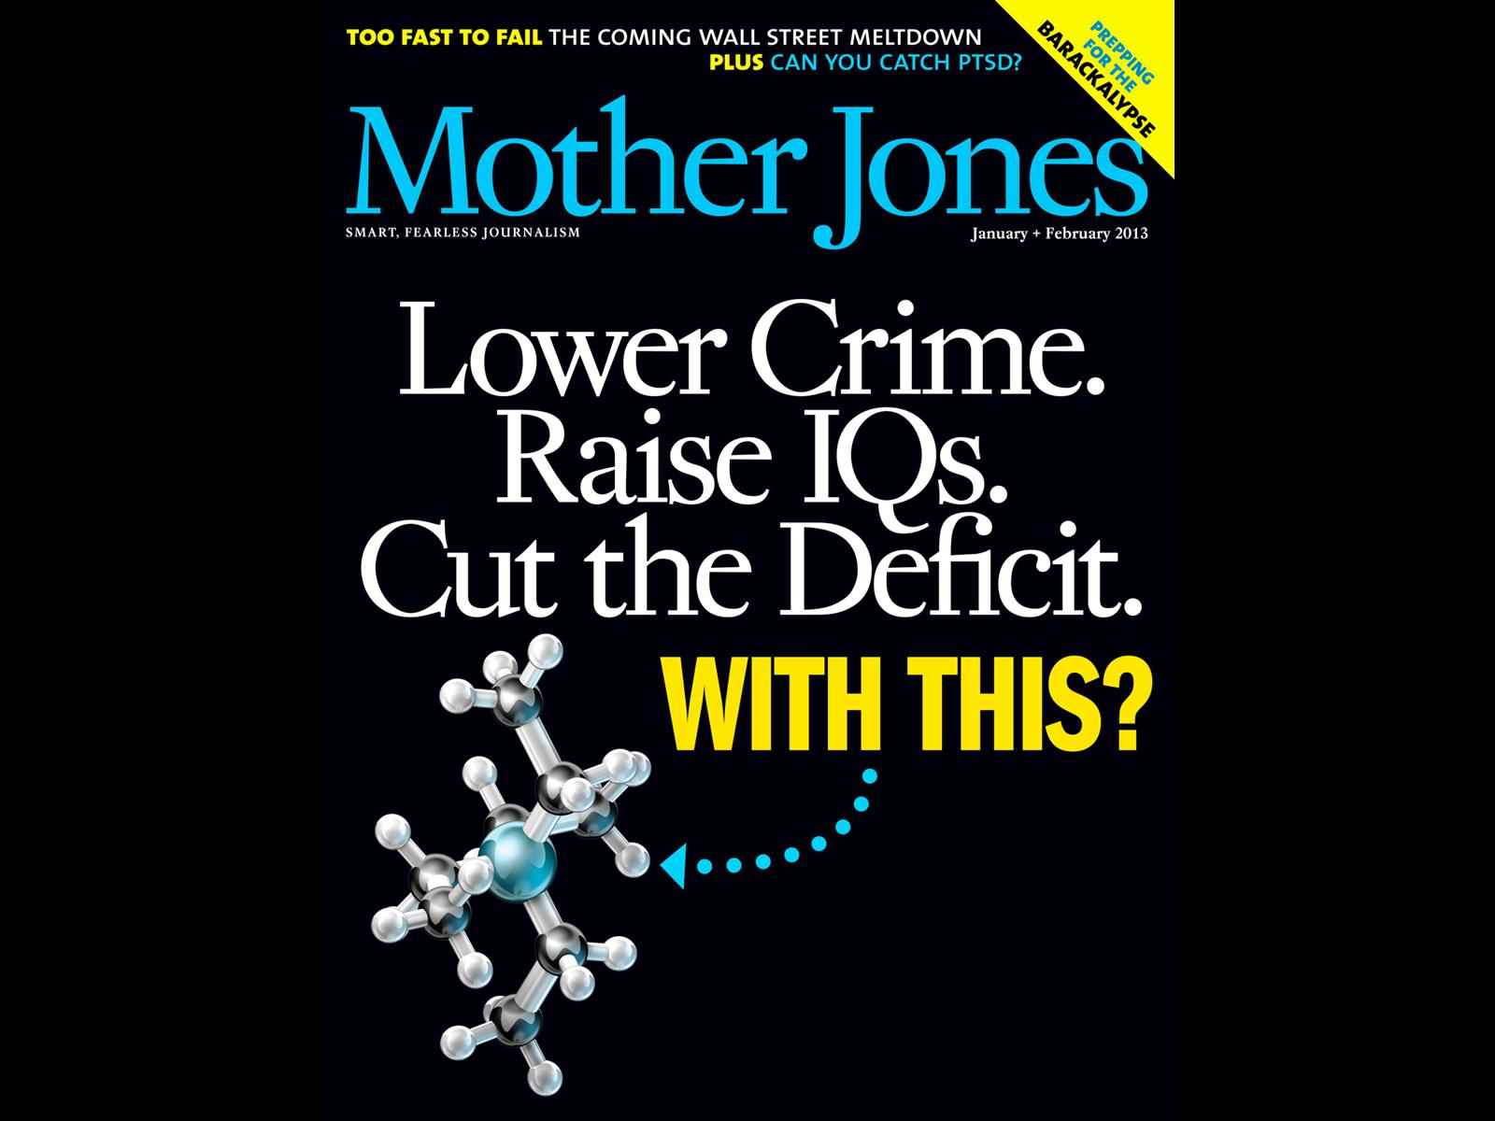

Slide 51
Adjusted Hazard Ratios for Blood Lead Levels and other Covariates, NHANES Mortality Study

Slide 52
Adjusted Hazard Ratios for Blood Lead Levels and other Covariates, NHANES Mortality Study

Slide 53
Risk Factors for Premature Deaths in US Adults NHANES Mortality Study

Slide 54
The Precipitous Decline in Hypertension in U.S. Adults > 20 years, NHANES

Slide 55
Blood Lead Levels and Hypertension in U.S. Adults > 20 years, NHANES

Slide 57
Blood Lead Levels and Public Health Policies in the United States, 1970-2010

Slide 59
The Global Elimination of Lead Poisoning

