Slide 1

Alternative Treatments For Lead Poisoning
Jacqueline Ehrlich, MD, MPH
Healthy Homes Program & Lead Poisoning Prevention
New York City Department of Health
and Mental Hygiene

Slide 2
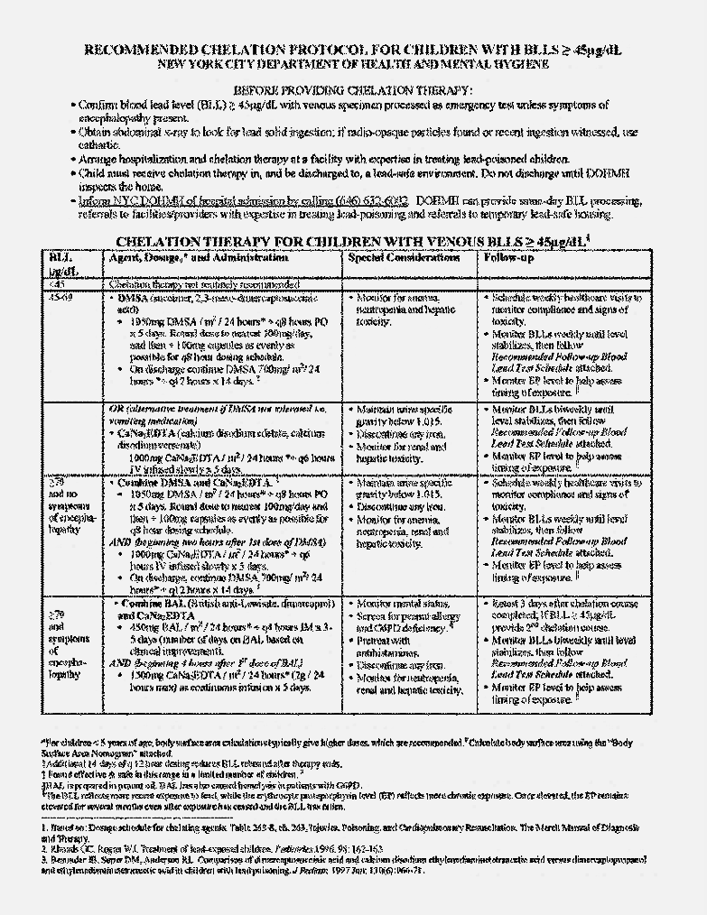
Chelation for BLLs > 45µg/dL
Remains Standard Therapy
4 chelating agents currently available:
  Dimercaprol or British AntiLewisite (BAL)
  CaNa₂EDTA or Ethylenediaminetetraacetic acid
  Succimer or 2,3-meso-dimercaptosuccinic acid (DMSA)
  D-Penicillamine
Different side effects & risks to each agent
Lifesaving for patients presenting with encephalopathy
No evidence it improves IQ or behavior
Mobilizes lead at accelerated rate
Currently only recommended for BLLs > 45µg/dL in children & pregnant women in second half of pregnancy
http://www1.nyc.gov/assets/doh/downloads/pdf/lead/lead-chelation.pdf
Notes:
Chelation mobilizes lead at accelerated rate in selected cases
No evidence exists that chelation avoids or reverses neurotoxic effects
Safety concerns exist about chelation actually translocating lead into CNS
Studies have shown chelation to be lifesaving for children presenting with lead encephalopathy
Currently chelation is only recommended for BLL>45
4 chelating agents currently available:
Dimercaprol or British AntiLewisite (BAL) IM
Calcium Disodium EDTA or Ethylenediaminetetraacetic acid IM/IV
Succimer or 2,3-meso-dimercaptosuccinic acid( DMSA) oral
D-Penicillamine oral
Dimercaprol or British AntiLewisite (BAL)-IM
Cannot be given with Fe, to people with G6PD or peanut allergy
50% get side effects including hypersensitivity reactions, fever, vomiting, elevated LFTS
Pretreatment with diphenhydramine recommended
Use recommended only for BLL>70
Calcium Disodium EDTA or Ethylenediaminetetraacetic acid-IM/IV
Primary side effects: nephropathy & translocation of lead into CNS
Succimer or 2,3-meso-dimercaptosuccinic acid( DMSA)-oral
Side effects include: anemia, neutropenia, hypersensitivity reactions & increased lead absorption so must give in lead-safe environment
D-Penicillamine-oral
Side effects include: eosinophilia, angioedema, hypersensitivity reactions and lead redistribution

Slide 3
Treatment for Lead Poisoning
Chelation therapy remains the standard
Market for over-the-counter chelating agents & alternative remedies created due to:
  Side effects of these agents &
  Increasing costs of these agents
  Unconventional usage to treat autism
During this talk, safety & utility of numerous remedies will be reviewed

Slide 4
Remedies Espoused on the Internet
Vitamins & Minerals
Herbs, Berries and Fruits
Amino Acids
Homeopathic
Low-fat Diet
Over-the-counter/Internet Chelating Agents

Slide 5
Nutrition and Lead
Human body’s nutritional status may affect absorption, deposition & excretion of lead as well as its toxicity
Existence of potential nutrient-lead interactions suggests optimizing nutritional status may assist in preventing consequences of lead exposure
Physiological mechanisms for potential nutrition-lead interactions include nutrients:
  Binding lead in the gut,
  Competing with lead for absorption,
  Altering intestinal cell avidity for lead,
  Altering affinity of target tissues for lead
  In tissues as antioxidants or anti-inflammatory agents
Because of limited randomized, controlled experiments of nutritional interventions in children and pregnant women with EBLLs, most recommendations based on:
  Generally accepted nutrition principles
  Results of non-pregnant adult, animal or cross sectional studies

Slide 6
Vitamins and Minerals

Slide 7
Calcium For Pregnant Women
Competes with lead for enzyme systems & can inhibit its absorption & bioavailability.
Increased lead absorption & tissue retention among overtly Ca-deficient experimental animals confirmed in multiple species.
Confirmation of impact of low dietary Ca intakes also found among human subjects with increased lead absorption when diets low in Ca
Ca 1,200mg at bedtime during 3rd trimester of pregnancy shown, in randomized crossover trial, to reduce maternal bone resorption by 14%, suggesting Ca supplements may reduce maternal bone lead mobilization during 3rd trimester.
Ca supplementation associated with modest reductions in BLLs both during pregnancy & lactation. Suppression of bone resorption most likely mechanism, although reduced absorption from GI tract may contribute.
For pregnant & lactating women with BLLs ≥5μg/dL or history of lead exposure, 2,000 mg of calcium daily should be maintained either through diet or in combination with supplements.
CDC. Guidelines for the Identification and Management of Lead Exposure in Pregnant and Lactating Women (2010)

Slide 8
Calcium for Children¹
Little evidence child typically considered at risk for lead exposure at greater risk for low calcium intake than children without EBLLs.
However, because of frequency of inadequate intake among children, important to verify child with EBLL receiving enough Ca.
Results of both animal & human studies provide good evidence dietary calcium competitively inhibits lead absorption.
  Results of one cross-sectional study of older children with controls for SES show inverse association between dietary calcium intake & BLLs.
  Limited studies evaluating Ca supplementation in young children with low Ca intakes & EBLLs showed inconsistent results in lowering BLL after 3m²
  Results of studies among older children & adults, animal studies & cross-sectional studies all reinforce importance of adequate calcium intake.
  However, no clinical evidence supplementation of calcium beyond recommended level in children with EBLLs has a clinical effect on the BLLs;
  Therefore, calcium supplementation in children with EBLLs not recommended beyond Adequate Intake levels.
Managing Elevated Blood Lead Levels Among Young Children: Recommendations from the Advisory Committee on Childhood Lead Poisoning Prevention, Centers for Disease Control & Prevention, Atlanta 2002.
Markowitz ME, Sinnett M, Rosen JF. A randomized trial of calcium supplementation for childhood lead poisoning. Pediatrics. 2004 Jan;113(1 Pt 1):e34-9

Slide 9
Iron for Pregnant Women
Studies of effect of iron supplementation in lead poisoned pregnant women not available
Iron supplementation in pregnant & lactating women should be consistent with those given for pregnancy & lactation
No additional iron supplementation recommended for women with EBLLs
Iron status should be evaluated & supplementation provided to correct any deficiency
CDC. Guidelines for the Identification and Management of Lead Exposure in Pregnant and Lactating Women (2010).

Slide 10
Iron for Children¹
Although may help prevent lead absorption in animals, studies of association between Fe deficiency & BLLs in children produced inconsistent results.
Fe deficiency associated with increased BLL age 12m.²
Fe supplements in children with EBLLs & Fe deficiency shown to improve developmental scores, suggesting effects on cognition partially reversible
Finding consistent with data indicating neurodevelopmental impairment in children with Fe-deficiency anemia partially resolved with Fe supplements.
Since effects of Fe deficiency on development appear independent of effects of lead, no reason to treat children with lead exposure differently
Giving children iron supplements not recommended except when iron deficiency or anemia documented
Iron supplementation should not occur during oral chelation therapy.³
1. Managing Elevated Blood Lead Levels Among Young Children: Recommendations from the Advisory Committee on Childhood Lead Poisoning Prevention, Centers for Disease Control & Prevention, Atlanta 2002.
2. LM. Schell , M Denham, AD Stark, Julia Ravenscroft, Patrick Parsons, Elaine Schulte. Relationship between blood lead concentration and dietary intakes of infants from 3 to 12 months of age. Environmental Research. Vol 96, Issue 3, November 2004, p 264–273.
3. Smith DR, Markowitz ME, Crick J, Rosen JF, Flegal AR. The effects of succimer on the absorption of lead in adults determined by using the stable isotope 204Pb. Environ Res. 1994 Oct;67(1):39-53.

Slide 11
Vitamin C for Pregnant Women
Suggested to act as natural chelating agent enhancing urinary elimination.
Decreased lead retention shown in rats fed vitamin C & exposed to lead.
Human subject studies also found Vit. C supplementation reduced BLLs.
Cases of lead-poisoned workers’ response to Vit. C in literature since 1939.
Two large cross-section­al studies in adults found associations between BLLs & dietary intake or serum levels of vitamin C.
In NHANES III, for >15,000 adults, adults in highest 2 serum vit C tertiles had 65% -68% lower prevalence of EBLLs compared to lowest tertile.
For >4,000 NHANES III women (20-49 years), women with high serum vit C levels had 2.5 lower odds of having BLLs in highest decile (>4µg/dL).
Among postpartum women in Mexico City, higher intakes of vitamin C associated with lower levels of breast milk lead.
Research suggests vitamin C may lower BLLs. However, dose unclear. Since studies conducted had small subject numbers & did not include pregnant women, further research needed.
CDC. Guidelines for the Identification and Management of Lead Exposure in Pregnant and Lactating Women (2010).

Slide 12
Vitamin C for Children
Less known about effect of vitamin C on BLLs in children
  One cross-sectional study using NHANES III data showed high levels of serum vitamin C associated with low prevalence of EBLLs for both children & adults.
  Results showed association between serum vitamin C levels & log BLLs among adults but not among children.
  Did not control for environmental lead risk or include kids < 4y.
  Although evidence to support giving vitamin C to non-pregnant adults with EBLLs, insufficient evidence to recommend supplementation for children with EBLLs.
Advise providing children adequate intake of vitamin C
Managing Elevated Blood Lead Levels Among Young Children: Recommendations from the Advisory Committee on Childhood Lead Poisoning Prevention, CDC, Atlanta 2002.

Slide 13
Vitamin D
2013 study of 90 battery manufacture workers selected & divided in 3 groups of 30 workers each depending on duration of lead exposure:
  Group I—exposure 1–5 years,
  Group II—exposure 6–10 years and
  Group III—exposure more than 10 years.
  30 age matched healthy control subjects taken for comparison.
  BLLs and serum vitamin D inversely correlated.¹
Because data on association of lead & vitamin D limited, no specific recommendation made for supplementation of vitamin D in lead poisoned pregnant women or children.²
Adequate levels of vitamin D should be maintained.
1. Nilima N. Dongre, Adinath N. Suryakar, Arun J. Patil, Indira A. Hundekari, and Basavaraj B. Devarnavadagi. Biochemical Effects of Lead Exposure on Battery Manufacture Workers with Reference to Blood Pressure, Calcium Metabolism and Bone Mineral Density. Indian J Clin Biochem. 2013 Jan; 28(1): 65–70.
Published online 2012 Jul 27.
2. CDC. Guidelines for the Identification and Management of Lead Exposure in Pregnant and Lactating Women (2010).

Slide 14
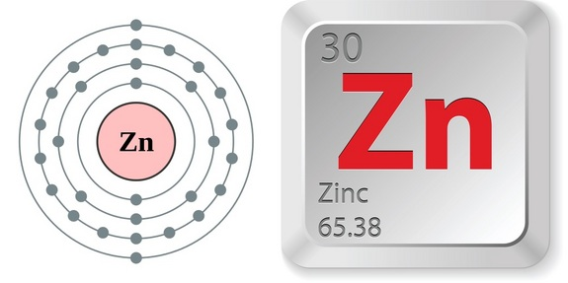
Zinc
Competes with lead for binding sites on some enzymes, such as delta aminolevulinic acid dehydratase.
Zinc deficiencies, may increase both lead absorption & toxicity
Some evidence from animal studies suggests high levels of dietary zinc inhibit absorption & retention of lead in animals.
However, in one small clinical study, zinc given with & without vitamin C to lead-exposed workers-zinc had no demonstrable effect on BLLs
Most American diets have suﬃcient sources of zinc
Thus, adding zinc supplements to diet of pregnant women or children with EBLLs not recommended.
Managing Elevated Blood Lead Levels Among Young Children: Recommendations from the Advisory Committee on Childhood Lead Poisoning Prevention, CDC, Atlanta 2002.

Slide 15
Selenium (Se)
Possible role on oxidative stress induced by lead unclear. One possible mechanism as cofactor for glutathione peroxidase (GPx), an antioxidant enzyme
2016 study explores associations among Se levels, chronic lead exposure, oxidative stress & parameters of antioxidant defense system in men occupationally exposed to lead.
Based on median serum Se concentrations, 324 study subjects divided into two subgroups:
  Subgroup with a low Se level (L-Se) and
  Subgroup with a high Se level (H-Se).
Lower serum Se associated with 6% higher BLLs and more oxidative stress indicated by higher lipofuscin level (pigment recognized as aging hallmark)
In low Se group, antioxidant defenses decreased (GSH level & GPx activity)
Studies limited and inadequate to recommend Se supplementation for lead exposure at higher doses than in a normal diet except for selenium deficiency.
Pawlas N, Dobrakowski M, Kasperczyk A, Kozłowska A, Mikołajczyk A, Kasperczyk S. The Level of Selenium and Oxidative Stress in Workers Chronically Exposed to Lead. Biol Trace Elem Res. 2016 Mar;170(1):1-8.

Slide 16
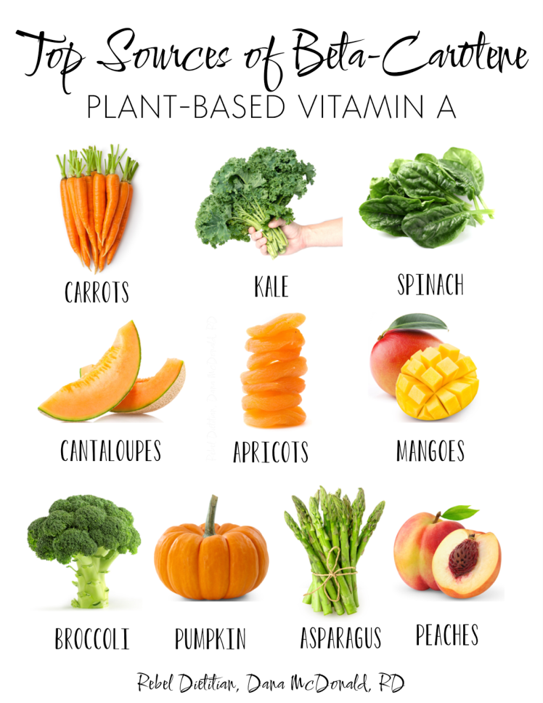
β-carotene
Red/orange/yellow pigment found in plants-precursor of vitamin A & known antioxidant.
2014 study to determine whether β-carotene reduces oxidative stress & homocysteine level in workers chronically exposed to lead.
Exposed population included healthy male workers exposed to lead randomly divided into 2 groups (mean BLL 44µg/dL).
  1st group (N = 49) had no dietary supplements administered,
  2nd group (N = 33) had beta-carotene administered 10mg/d x 12w.
Markers of oxidative stress measured: levels of malondialdehyde (MDA) & homocysteine (Hcy) & activity of superoxide dismutase (SOD) & its isoenzyme EC-SOD.
Kasperczyk S, Dobrakowski M, Kasperczyk J, Romuk E, Prokopowicz A, Birkner E. The influence of beta-carotene on homocysteine level and oxidative stress in lead-exposed workers. Med Pr. 2014;65(3):309-16.

Slide 17
β-carotene Results
After supplementation, MDA level decreased 16% compared to baseline & reference group. Hcy level also decreased.
However, level of thiol groups significantly higher. Activity of SOD & EC-SOD also higher compared to baseline & reference group.
Observed to have antioxidant action & exert some beneficial effects in lead poisoned workers.
Research conducted to date insufficient to recommend β-carotene supplementation.

Slide 18
Herbs, Berries & Fruits
Numerous plant products have been shown to have antioxidant activity, and antioxidant vitamins, flavonoids, and polyphenolic compounds of plant origin are investigated as scavengers of free radicals & inhibitors of lipid peroxidation.

Slide 19
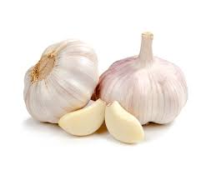
Garlic (Allium sativum)
Garlic (Allium sativum) is an herbal product considered to have chelating effect in some animal studies.
In controlled double-blind clinical trial in Iran on 117 battery plant workers with lead poisoning, workers divided into 2 groups
  Garlic powder 400mg (=1200μg allicin =2g fresh garlic) 3x daily x 4w
  D-penicillamine 250mg, 3 x daily x 4w
Mean BLLs reduced in both groups with no significant difference.( 42.6 to 34.7μg/dL in garlic group & 41.7 to 31.6μg/dL in d-penicillamine group)
Frequency of adverse effects significantly lower in garlic group compared to D-penicillamine group.
Neurological signs & symptoms such as irritability, headache & decreased DTR decreased.
Garlic may be significantly effective in reducing BLLs in patients with chronic lead poisoning.
Kianoush S, Balali-Mood M, Mousavi SR, Moradi V, Sadeghi M, Dadpour B, Rajabi O, Shakeri MT. Comparison of therapeutic effects of garlic and d-Penicillamine in patients with chronic occupational lead poisoning. Basic Clin Pharmacol Toxicol. 2012 May;110(5):476-81.

Slide 20
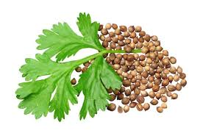
Cilantro
(Coriandrum Sativum)
Leaves rich in vit A, C & K. Seeds significant amounts of fiber, Ca, Se, Fe, Mg & Mn.
32 children aged 3-7y, with lead-exposed worker parent, randomly divided into 2 groups; Duration of fathers' exposure to Pb at work 9 ± 6y
  Test group received Cilantro extract &
  Controls given placebos for 14d
Blood & urine lead concentrations determined at study beginning & 14d later.
BLL 16µg/dL & urine Pb 10µg/dL & renal lead clearance .012 L/d at beginning of study. No differences between 2 groups.
K. Deldar, E. Nazemi, M. Balali Mood, SA. Emami, AH. Mohammad Pour, M. Tafaghodi et al . Effect of Coriandrum sativum extract on lead excretion in 3-7 year old children. J Birjand Univ Med Sci.. 2008; 15 (3) :11-19.

Slide 21
Cilantro Results
After 2w use of Cilantro, mean BLL decreased, urine lead increased & renal excretion of lead increased. But similar changes in control group.
Increasing lead elimination in both groups may have been due to other factors like improvement in nutrition following education at study beginning
Study double-blind, but some mothers may have realized the medicine was coriander & may have given it to placebo group.
Thus, cilantro does not appear effective in lead elimination, although previous animal experiment on mice reported it as effective.

Slide 22
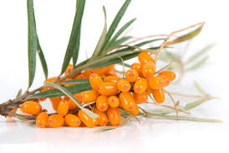
Seabuckthorn Juice
Shrub found in China, Mongolia, Russia, northern Europe & Canada
Ripe fruit rich source of vitamins A, C, E, & K, carotenoids, & organic acids. Long history in Tibetan & Mongolian medicine in treatment of various diseases.
Examined effect of Hippophae rhamnoides L. (HRL) juice on lead-induced memory impairment & neuronal damage in brains of Kunming adult mice.
In lead-only group-mice exposed to lead acetate 10mg/kg for 20d.
  In water maze test, swimming time lengthened
  Product of lipid oxidation malondialdehyde levels & neurotransmitter breakdown enzymes acetylcholinesterase & monoamine oxidase activity increased
  Levels of catecholamine neurotransmitters norepinephrine (NE) , serotonin & 5-hydroxyindole acetic acid (HIAA) decreased
Yanji XU, Guangzhe LI, Chunji HAN, Lianping SUN, Rongjie ZHAO, and Santian CUI. Protective Effects of Hippophae rhamnoides L. Juice on Lead-Induced Neurotoxicity in Mice. Biol. Pharm. Bull. 28(3) 490—494 (2005).

Slide 23
Seabuckthorn Juice Results
Then either no HRL, 20% HRL or 40 % given. In HRL groups:
  Swimming time decreased in mice receiving 20% & 40% HRL
  Malondialdehyde levels reduced in 20% & 40% HRL groups in dose-dependent manner
  Activities of acetylcholinesterase & monoamine oxidase decreased in 40% HRL group but not 20% HRL
  Levels of NE, serotonin & 5-HIAA increased in 40% HRL group, but 20% HRL had no effect
Data suggest HRL juice may protect against lead-induced deficits in memory & changes in neuro-biochemical parameters in mice.

Slide 24
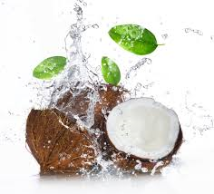
Coconut Water
Study in 2016 to determine effect of coconut water on hemato-biochemical changes due to lead in wistar albino rats
60 rats assigned to 4 groups
  Lead 0.10g/l water daily intraperitoneal x 6w
  75ml coconut water daily x 6w
  lead 0.10g/l of water+ 75ml coconut water daily x 6w
  healthy control group
In lead-treated rats when compared to controls:
  Mean RBCs, MCV, MCH, MCHC, RDW & PLT counts reduced
  WBCs, TL, TG, HDL, LDL, LDL/HDL & TL/HDL increased
EB JESUORSEMWEN, II EBIKERE, IN OZEDE, A F EGHOMWANRE. Hematobiochemical changes of lead Poisoning and amelioration with Coconut (Cocos nucifera L.) Water in wistar albino rats J. Appl. Sci. Environ. Manage. March., 2016 Vol. 20 (1) 89 – 94.

Slide 25
Coconut Water Results
In coconut water treated groups:
    All hematologic values increased except MCV, MCHC, & RDW in coconut water only group.
    All lipid values decreased, except HDL.
Reduction in RBC values might be due to decreased life span & increased fragility of RBCs & inhibitory effect of lead on RBC enzymes; Ability of coconut water to counteract might be because it contains iron & folate
Exposure to lead causes tissue inflammation & alters metabolism of cholesterol; Reductions in coconut water groups may be due to anti-oxidant & anti-inflammatory effects
Results indicate that coconut water may ameliorate effects of lead toxicity in rats.
EB JESUORSEMWEN, II EBIKERE, IN OZEDE, A F EGHOMWANRE. Hematobiochemical changes of lead Poisoning and amelioration with Coconut (Cocos nucifera L.) Water in wistar albino rats J. Appl. Sci. Environ. Manage. March., 2016 Vol. 20 (1) 89 – 94.

Slide 26
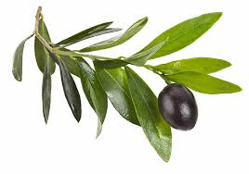
Olive Leaves
Olive leaves have antioxidant capacity.
2013 study to determine whether olive leaf extract can inhibit lead-induced brain injury, & whether this effect is associated with antioxidant capacity.
First, lead acetate administered to mice intra gastric for 30d. Then, mice given olive leaf extract at doses of 250, 500 or 1 000mg/kg daily for 50d.
Under transmission electron microscope, attenuated neuronal & capillary injury & reduced damage to organelles & matrix around capillaries in frontal lobe of cerebral cortex. Extract dose 1000mg/kg greatest effect.
Spectrophotometry showed increased activities of SOD, catalase, alk phos & acid phos while reducing malondialdehyde content, in dose-dependent manner.
Immuno-histochemical staining revealed dose-dependent decrease in apoptotic activator Bcl-2-associated X protein (Bax) expression in cerebral cortex.
Thus, olive leaf extract may inhibit lead-induced brain injury by increasing antioxidant capacity & reducing apoptosis.
Wang, Y., Wang, S., Cui, W., He, J., Wang, Z., & Yang, X. (2013). Olive leaf extract inhibits lead poisoning-induced brain injury. Neural Regeneration Research, 8(22), 2021–2029.

Slide 27
Turmeric
2006 Egyptian study on effects of lead acetate in diet on reduced glutathione (GSH), activity glutathione S-transferase (GST), & lipid peroxidation in liver homogenate & bone marrow chromosomes of mice supplemented with turmeric or myrrh for 8w.
5 groups of Swiss male albino mice, 30 mice each
  First group served as negative control
  Second group received diet with lead acetate only and served as positive control
  Other 3 groups received lead acetate AND 1% or 5% turmeric powder or 1% myrrh powder
IM. El-Ashmawy, KM. Ashry, Abeer F. El-Nahas and OM. Salama. Protection by Turmeric and Myrrh against Liver Oxidative Damage and Genotoxicity Induced by Lead Acetate in Mice. C Basic & Clinical Pharmacology & Toxicology 2006, 98, 32–37.

Slide 28
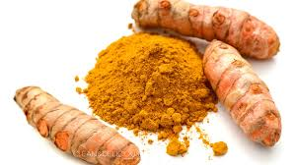
Turmeric Results
Decrease in GSH in all treated groups compared with negative control.
Activity of GST decreased & lipid peroxidation increased in lead group
Administration of plants increased GST activity compared to both controls.
Treatment with plants resulted in reduction lipid peroxidation level by
  31% & in mice receiving 1% turmeric
  49% in mice receiving 5% turmeric
  45% in mice receiving 1% myrrh
Reduced genotoxicity (reduction in #dividing cells, #aberrant cells & frequency of chromosomal aberrations) observed with 5% turmeric only.
Turmeric & myrrh may potentially help to control oxidative damage & genotoxicity induced by lead acetate.
IM. El-Ashmawy, KM. Ashry, Abeer F. El-Nahas and OM. Salama. Protection by Turmeric and Myrrh against Liver Oxidative Damage and Genotoxicity Induced by Lead Acetate in Mice. C Basic & Clinical Pharmacology & Toxicology 2006, 98, 32–37.

Slide 29
Contaminated Turmeric in NYC
During home visits for NYC lead-poisoned children, based on risk assessments, DOHMH collects samples of potentially contaminated products
Since 2007, 227 samples of turmeric tested
33% (76) samples with ≥10ppm lead
  Range 10-2000ppm
  Mean 627ppm
  46 purchased in Bangladesh, 10 in US, 1 Morocco, 1 Pakistan, 1 India
DOHMH unpublished data

Slide 30
Amino-acids

Slide 31
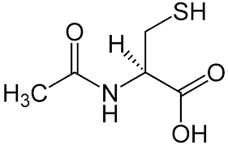
N-acetylcysteine (NAC)
Precursor to antioxidant glutathione
Possesses reactive groups, such as thiol, hydroxyl & amine, which can bind lead & remove it from the body.
Experimental studies with rats suggest oxidative stress induced by lead reduced by sulphur-containing compounds.
2015 study of 171 workers occupationally exposed to lead found those treated with NAC showed reduction in BLLs.
In addition, all groups receiving NAC had elevated activity of glutamate dehydrogenase. NAC normalized level of homocysteine & decreased oxidative stress.
NAC potential therapy for chronic lead toxicity
Kasperczyk S, Dobrakowski M, Kasperczyk A, Romuk E, Rykaczewska-Czerwińska M, Pawlas N, Birkner E. Effect of N-acetylcysteine administration on homocysteine level, oxidative damage to proteins, and levels of iron (Fe) and Fe-related proteins in lead-exposed workers. Toxicol Ind Health. 2016 Sep;32(9):1607-18.

Slide 32
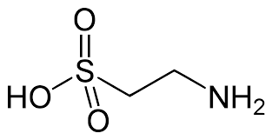
Taurine
Amino acid that can be manufactured by the body & known antioxidant
Best food sources are meat and fish.
2004 study describes dose-dependent effect of taurine (50-100mg/kg daily x 5d), either alone or in combination with DMSA (DMSA 50mg/kg once daily x 5d) in treatment of subchronic lead intoxication in male rats
Lead exposure produced inhibition of ALAD activity & reduction in GSH
Only DMSA increased ALAD activity; both taurine & DMSA increased GSH.
Animals treated with taurine reduced alterations in some parameters indicative of oxidative stress.
  Byproduct of lipid peroxidation, thiobarbituric acid reactive substance levels reduced, while GSH level increased.
  Activity of SOD increased in blood & brain of rats.
Concomitant administration of taurine with thiol chelators could play a role in abating toxic effects of lead. Further research needed.
Flora SJ, Pande M, Bhadauria S, et al. Combined administration of taurine and meso 2,3-dimercaptosuccinic
acid in the treatment of chronic lead intoxication in rats. Hum Exp Toxicol 2004;23(4):157-66.

Slide 33
Other Remedies

Slide 34
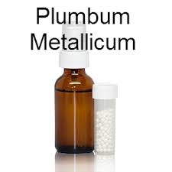
Homeopathic:
Plumbum metallicum
2011 Double-blind randomized trial
131 Ajax battery plant workers in Bauru, São Paulo, Brazil
Plumbum metallicum 15 cH or placebo, orally for 35 days
CH-dilutions are centesimal (C) dilutions, using Hahnemann’s (H) method.
  Mother tincture diluted to 1/100 & shaken vigorously. This dilution known as 1 CH.
  When 1 CH diluted again, following same process, 1/ 10,000 dilution results, or 2 CH.
  This can then be diluted again to create 3 CH and so on.
% workers with ≥ 25% reduction in BLL same: 20.3% in homeopathic group vs 21% in control group
Plumbum metallicum had no effect in reducing blood lead levels in lead-exposed workers
Padilha RQ, Riera R, Átallah AN. Homeopathic Plumbum metallicum for lead poisoning: a randomized clinical trial. Homeopathy. 2011 Jul;100(3):116-21.

Slide 35
Low-Fat Diets
Link between fat intake & BLLs primarily from animal experiments.
In one cross-sectional study, researchers found a direct association between dietary fat & BLLs;
However, no such relationship found in NHANES II.
Thus, no strong case can be made for decreasing children’s total fat intake.
In addition, dietary fat important in diets of children under 2y of age because calories from fat support high calorie requirements for growth during this period.
Thus, low-fat diets for the treatment of younger children with EBLLs not recommended.

Slide 36
Oral Chelating Agents
Already mentioned standard of care for children and women in 2nd second half of pregnancy with BLLs ≥45µg/dL typically include chelation
However, treatment with succimer to lower BLLs 20-44 in toddlers was not shown to improve cognition*
Lack of evidence to recommend lead chelation for children or pregnant women with BLLs <45µg/dL
*Xianchen Liu, MD, PhD; Kim N. Dietrich, PhD; Jerilynn Radcliffe, PhD; N. Beth Ragan; George G. Rhoads, MD; and Walter J. Rogan, MD. Do Children With Falling Blood Lead Levels Have Improved Cognition?
Pediatrics 2002;110;787-791.

Slide 37
FDA Warning of Unapproved
Chelation Products 10/14/10
Increase noted in products marketed on internet claiming to cleanse body of toxic heavy metals & treat range of diseases, including ASD, cardiovascular dxs, Parkinson’s dx, Alzheimer’s dx, & macular degeneration
Come in various forms, including trans-mucosal sprays, suppositories, capsules, liquid drops & clay baths
Have not been evaluated by FDA for tx of these dxs
Effectiveness in treating any dxs listed unsubstantiated
No FDA-approved OTC chelation products. Only FDA-approved chelating agents available by prescription for specific indications i.e.lead poisoning & iron overload
“These products are dangerously misleading because they are targeted to patients with serious conditions and limited treatment options,” said Deborah Autor, director of Office of Compliance in FDA’s Center for Drug Evaluation & Research. “The FDA must take a firm stand against companies who prey on the vulnerability of patients seeking hope and relief.”
8 companies warned their products are unapproved drugs & violation of federal law to make unproven claims about these products
http://www.fda.gov/NewsEvents/Newsroom/PressAnnouncements/ucm229320.htm

Slide 38
FDA Warning Letters Sent to:
  World Health Products, LLC: Detoxamin Oral, Detoxamin Suppositories
  Hormonal Health, LLC: Kelatox Suppositories
  Evenbetternow, LLC: Kids Chelat Heavy Metal Chelator, Bio-Chelat Heavy Metal Chelator, Behavior Balance DMG Liquid, AlkaLife Alkaline Drops, NutriBiotic Grapefruit Seed Extract, Natur-Leaf, Kids Clear Detoxifying Clay Baths, EBN Detoxifying Bentonite Clay
  Maxam Nutraceutics/Maxam Laboratories: PCA-Rx, PC3x, AFX, AD-Rx, AN-Rx, Anavone, AV-Rx, BioGuard, BSAID, CF-Rx, CreOcell, Dermatotropin, Endotropin, GTF-Rx, IM-Rx, Keto-Plex, Natural Passion, NG-Rx, NX-Rx, OR-Rx, Oxy-Charge, PN-Rx, Ultra-AV, Ultra Pure Yohimbe
  Cardio Renew, Inc: CardioRenew & CardioRestore
  Artery Health Institute, LLC: Advanced Formula EDTA Oral Chelation
  Longevity Plus: Beyond Chelation Improved, EndoKinase, Viral Defense, Wobenzym-N
  Dr. Rhonda Henry: Cardio Chelate (H-870)

Slide 39
ASD Chelation Study
National Institute of Mental Health Clinical Trials Identifier: NCT00376194
First received: 9/13/06; Last updated: 9/17/13
Chelation widely used to treat individuals with ASD, with some surveys estimating 1 in 12 children with autism have undergone chelation.
Widespread use reflects hypothesis ASD caused by exposure to thimerosal, an ethylmercury-based compound used previously as vaccine preservative.
Prevalent use in contrast with lack of scientific or clinical evidence of efficacy. Support based on single-case reports of benefits of DMSA.
Thus, double-blind, randomized placebo-controlled study among 120 children, 4-10y with ASD on effects of DMSA on behavior proposed;
Objective to quantify differences in behavioral functioning between chelation treatment group and placebo control group.
Study withdrawn prior to enrollment
https://clinicaltrials.gov/ct2/show/NCT00376194

Slide 40
Future Research
Only clinical trials employing randomized designs
can determine whether modifying intake of specific nutrients will actually influence BLLs

